Slide 1
Course Name: Computer Organization and Architecture
Course Code: CS45
Credits: 3:1:0
UNIT 2
Term: March – June 2021
M.S. Ramaiah Institute of Technology
(Autonomous Institute, Affiliated to VTU)
Department of Computer Science and Engineering
Faculty:
  Chandrika P
  Vandana S Sardar
  Sowmya B J
  Dr.Sangeetha V
DEPARTMENT OF COMPUTER SCIENCE AND ENGINEERING

Slide 2
UNIT 2 – Arithmetic unit & Processing unit
Multiplication of two Numbers
A Signed Operand Multiplication
  Booth algorithm
Fast Multiplication
  Bit pair recoding
  Carry Save Addition(CSA)
Integer Division
    Restoring Division
    No restoring Division
IEEE standard for floating point numbers
Fundamental concepts
Execution of complete instruction
Multiple bus organization
Hardwired control
Microprogrammed control
DEPARTMENT OF COMPUTER SCIENCE AND ENGINEERING

Slide 3
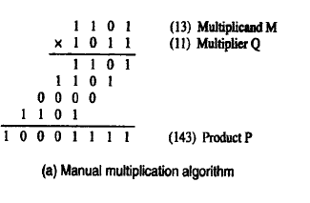
Multiplication of unsigned numbers
Algorithm for multiplying unsigned number and positive signed numbers.
The product of two n-digit number can be accommodated in 2n digits
n=4 digits 🡪 2*4= 8 digits
DEPARTMENT OF COMPUTER SCIENCE AND ENGINEERING
Notes:
‹#›

Slide 4
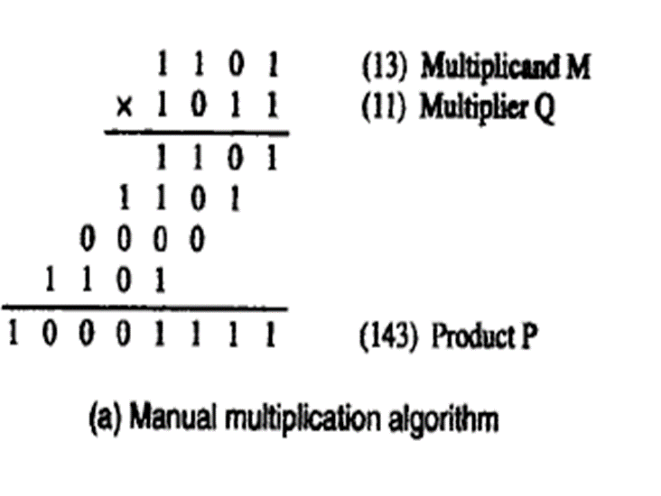
Multiplication of unsigned numbers
Algorithm for multiplying unsigned number
  If the multiplier bit is 1, the multiplicand is entered in the appropriate position to be added to the partial product.
  If the multiplier bit is 0, then 0s are entered in the appropriate position to be added to the partial product.
DEPARTMENT OF COMPUTER SCIENCE AND ENGINEERING
Notes:
‹#›

Slide 5
2
13
2
6
1
13 (Multiplicand M) 1101 | * | 11 (Multiplier Q) =143 1011
2
3
0
M |  |  |  |  | 1 | 1 | 0 | 1
Q |  |  |  |  | 1 | 0 | 1 | 1
P
1
1
DEPARTMENT OF COMPUTER SCIENCE AND ENGINEERING

Slide 6
2
13
2
6
1
13 (Multiplicand M) 1101 | * | 11 (Multiplier Q) =143 1011
2
3
0
M |  |  |  |  | 1 | 1 | 0 | 1
Q |  |  |  |  | 1 | 0 | 1 | 1
 |  |  |  |  | 1 | 1 | 0 | 1
P
1
1
DEPARTMENT OF COMPUTER SCIENCE AND ENGINEERING

Slide 7
2
13
2
6
1
13 (Multiplicand M) 1101 | * | 11 (Multiplier Q) =143 1011
2
3
0
M |  |  |  |  | 1 | 1 | 0 | 1
Q |  |  |  |  | 1 | 0 | 1 | 1
 |  |  |  |  | 1 | 1 | 0 | 1
 |  |  |  | 1 | 1 | 0 | 1
P
1
1
DEPARTMENT OF COMPUTER SCIENCE AND ENGINEERING

Slide 8
2
13
2
6
1
13 (Multiplicand M) 1101 | * | 11 (Multiplier Q) =143 1011
2
3
0
M |  |  |  |  | 1 | 1 | 0 | 1
Q |  |  |  |  | 1 | 0 | 1 | 1
 |  |  |  |  | 1 | 1 | 0 | 1
 |  |  |  | 1 | 1 | 0 | 1
 |  |  | 0 | 0 | 0 | 0
P
1
1
DEPARTMENT OF COMPUTER SCIENCE AND ENGINEERING

Slide 9
2
13
2
6
1
13 (Multiplicand M) 1101 | * | 11 (Multiplier Q) =143 1011
2
3
0
M |  |  |  |  | 1 | 1 | 0 | 1
Q |  |  |  |  | 1 | 0 | 1 | 1
 |  |  |  |  | 1 | 1 | 0 | 1
 |  |  |  | 1 | 1 | 0 | 1
 |  |  | 0 | 0 | 0 | 0
 |  | 1 | 1 | 0 | 1
P
1
1
DEPARTMENT OF COMPUTER SCIENCE AND ENGINEERING

Slide 10
2
13
2
6
1
13 (Multiplicand M) 1101 | * | 11 (Multiplier Q) =143 1011
2
3
0
M |  |  |  |  | 1 | 1 | 0 | 1
Q |  |  |  |  | 1 | 0 | 1 | 1
 |  |  |  |  | 1 | 1 | 0 | 1
 |  |  |  | 1 | 1 | 0 | 1
 |  |  | 0 | 0 | 0 | 0
 |  | 1 | 1 | 0 | 1
P |  |  |  |  |  |  |  | 1
1
1
DEPARTMENT OF COMPUTER SCIENCE AND ENGINEERING

Slide 11
2
13
2
6
1
13 (Multiplicand M) 1101 | * | 11 (Multiplier Q) =143 1011
2
3
0
M |  |  |  |  | 1 | 1 | 0 | 1
Q |  |  |  |  | 1 | 0 | 1 | 1
 |  |  |  |  | 1 | 1 | 0 | 1
 |  |  |  | 1 | 1 | 0 | 1
 |  |  | 0 | 0 | 0 | 0
 |  | 1 | 1 | 0 | 1
P |  |  |  |  |  |  | 1 | 1
1
1
DEPARTMENT OF COMPUTER SCIENCE AND ENGINEERING

Slide 12
2
13
2
6
1
13 (Multiplicand M) 1101 | * | 11 (Multiplier Q) =143 1011
2
3
0
M |  |  |  |  | 1 | 1 | 0 | 1
Q |  |  |  |  | 1 | 0 | 1 | 1
 |  |  |  |  | 1 | 1 | 0 | 1
 |  |  |  | 1 | 1 | 0 | 1
 |  |  | 0 | 0 | 0 | 0
 |  | 1 | 1 | 0 | 1
P |  |  |  |  |  | 1 | 1 | 1
1
1
DEPARTMENT OF COMPUTER SCIENCE AND ENGINEERING

Slide 13
2
13
2
6
1
13 (Multiplicand M) 1101 | * | 11 (Multiplier Q) =143 1011
2
3
0
M |  |  |  |  | 1 | 1 | 0 | 1
Q |  |  |  |  | 1 | 0 | 1 | 1
 |  |  |  | 1 | 1 | 1 | 0 | 1
 |  |  |  | 1 | 1 | 0 | 1
 |  |  | 0 | 0 | 0 | 0
 |  | 1 | 1 | 0 | 1
P |  |  |  |  | 1 | 1 | 1 | 1
1
1
DEPARTMENT OF COMPUTER SCIENCE AND ENGINEERING

Slide 14
2
13
2
6
1
13 (Multiplicand M) 1101 | * | 11 (Multiplier Q) =143 1011
2
3
0
M |  |  |  |  | 1 | 1 | 0 | 1
Q |  |  |  |  | 1 | 0 | 1 | 1
 |  |  |  | 1 | 1 | 1 | 0 | 1
 |  |  | 1 | 1 | 1 | 0 | 1
 |  |  | 0 | 0 | 0 | 0
 |  | 1 | 1 | 0 | 1
P |  |  |  | 0 | 1 | 1 | 1 | 1
1
1
DEPARTMENT OF COMPUTER SCIENCE AND ENGINEERING

Slide 15
2
13
2
6
1
13 (Multiplicand M) 1101 | * | 11 (Multiplier Q) =143 1011
2
3
0
M |  |  |  |  | 1 | 1 | 0 | 1
Q |  |  |  |  | 1 | 0 | 1 | 1
 |  |  |  | 1 | 1 | 1 | 0 | 1
 |  |  | 1 | 1 | 1 | 0 | 1
 |  | 1 | 0 | 0 | 0 | 0
 |  | 1 | 1 | 0 | 1
P |  |  | 0 | 0 | 1 | 1 | 1 | 1
1
1
DEPARTMENT OF COMPUTER SCIENCE AND ENGINEERING

Slide 16
2
13
2
6
1
13 (Multiplicand M) 1101 | * | 11 (Multiplier Q) =143 1011
2
3
0
M |  |  |  |  | 1 | 1 | 0 | 1
Q |  |  |  |  | 1 | 0 | 1 | 1
 |  |  |  | 1 | 1 | 1 | 0 | 1
 |  |  | 1 | 1 | 1 | 0 | 1
 |  | 1 | 0 | 0 | 0 | 0
 |  | 1 | 1 | 0 | 1
P | 1 | 0 | 0 | 0 | 1 | 1 | 1 | 1
1
1
DEPARTMENT OF COMPUTER SCIENCE AND ENGINEERING

Slide 17
2
13
2
6
1
13 (Multiplicand M) 1101 | * | 11 (Multiplier Q) =143 1011
2
3
0
M |  |  |  |  | 1 | 1 | 0 | 1
Q |  |  |  |  | 1 | 0 | 1 | 1
 |  |  |  | 1 | 1 | 1 | 0 | 1
 |  |  | 1 | 1 | 1 | 0 | 1
 |  | 1 | 0 | 0 | 0 | 0
 |  | 1 | 1 | 0 | 1
P | 1 | 0 | 0 | 0 | 1 | 1 | 1 | 1
1
1
P | 1 | 0 | 0 | 0 | 1 | 1 | 1 | 1
 | 2⁷ | 2⁶ | 2⁵ | 2⁴ | 2³ | 2² | 2¹ | 2⁰
 | 128 |  |  |  | 8 | 4 | 2 | 1
128+8+4+2+1 = 143
DEPARTMENT OF COMPUTER SCIENCE AND ENGINEERING

Slide 18
Implementation of Multiplication
Array multiplier
Sequential multiplier
Booth multiplier
DEPARTMENT OF COMPUTER SCIENCE AND ENGINEERING

Slide 19
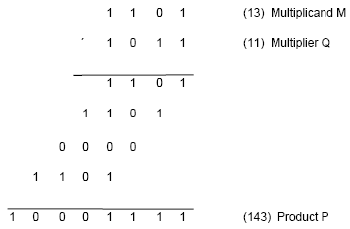
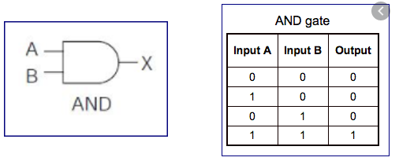
Multiplication of Positive Numbers
Simple algorithm
DEPARTMENT OF COMPUTER SCIENCE AND ENGINEERING

Slide 20
Multiplication of Positive Numbers
m₃
m₂
m₁
m₀
q₀
m₃
m₂
m₁
m₀
q₁
DEPARTMENT OF COMPUTER SCIENCE AND ENGINEERING

Slide 21
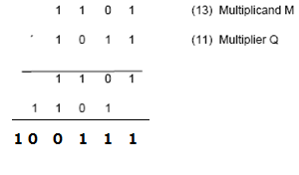
Multiplication of Positive Numbers
m₃
m₂
m₁
m₀
q₀
m₃
m₂
m₁
m₀
q₁
FA
FA
FA
FA
DEPARTMENT OF COMPUTER SCIENCE AND ENGINEERING

Slide 22
Multiplication of Positive Numbers
Binary multiplication of positive operands can be implemented in a combinational 2D logic array
Multiplicand
0
m
3
0
m
2
0
m
1
0
m
0
(PP0)
q
0
0
PP1
p
q
0
0
1
PP2
p
Multiplier
q
1
0
2
PP3
p
q
2
0
3
,
p
7
p
6
p
5
p
4
p
3
DEPARTMENT OF COMPUTER SCIENCE AND ENGINEERING

Slide 23
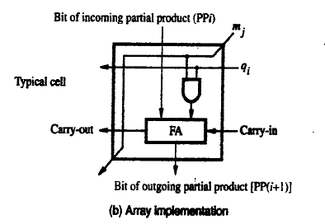
Implementation of Multiplication
The main component in each cell is a full adder
Multiplicand
0
m
3
0
m
2
0
m
1
0
m
0
(PP0)
q
0
0
PP1
p
q
0
0
1
PP2
p
Multiplier
q
1
0
2
PP3
p
q
2
0
3
,
p
7
p
6
p
5
p
4
p
3
DEPARTMENT OF COMPUTER SCIENCE AND ENGINEERING
Notes:
‹#›

Slide 24
Implementation of Multiplication
The AND gate in each cell determines whether a multiplicand bit m_{j}, is added to the incoming partial- product bit, based on the value of the multiplier bit q_{i}
Multiplicand
0
m
3
0
m
2
0
m
1
0
m
0
(PP0)
q
0
0
PP1
p
q
0
0
1
PP2
p
Multiplier
q
1
0
2
PP3
p
q
2
0
3
,
p
7
p
6
p
5
p
4
p
3
DEPARTMENT OF COMPUTER SCIENCE AND ENGINEERING
Notes:
‹#›

Slide 25
Combinatorial array multiplier
Combinatorial array multipliers are:
  Extremely inefficient.
  Have a high gate count for multiplying numbers of practical size such as 32-bit or 64-bit numbers.
  Perform only one function, namely, unsigned integer product.
Improve gate efficiency by using a mixture of combinatorial array techniques and sequential techniques requiring less combinational logic.
DEPARTMENT OF COMPUTER SCIENCE AND ENGINEERING
Notes:
‹#›

Slide 26
Sequential multiplication
Recall the rule for generating partial products:
  If the ith bit of the multiplier is 1, add the appropriately shifted multiplicand to the current partial product.
  Multiplicand has been shifted left when added to the partial product.
However, adding a left-shifted multiplicand to an unshifted partial product is equivalent to adding an unshifted multiplicand to a right-shifted partial product.
DEPARTMENT OF COMPUTER SCIENCE AND ENGINEERING
Notes:
‹#›

Slide 27
Sequential multiplication procedure
Multiplicand(M) and Multiplier(Q) bits are loaded into register, C is initially set to 0, Register A is initially set to 0
0th Bit of Multiplier is checked
If 0th bit = 1
  Multiplicand and partial product is added
  All bits of Q, A and C registers are shifted to right one bit
If 0th bit = 0
  No addition is performed, only shift operation is carried out
  Step 2, 3 and 4 are repeated n times to get desired result in A and Q registers
DEPARTMENT OF COMPUTER SCIENCE AND ENGINEERING
Notes:
‹#›

Slide 28

Sequential multiplication
Multiply using sequential circuit multiplier 13 x 11
M
1 1 0 1
Initial configuration
0
0 0 0 0
1 0 1 1
C
A
Q
0
1 1 0 1
1 0 1 1
Add
First cycle
0
0 1 1 0
1 1 0 1
Shift
1
0 0 1 1
1 1 0 1
Add
Second cycle
0
1 0 0 1
1 1 1 0
Shift
0
1 0 0 1
1 1 1 0
No add
Third cycle
0
0 1 0 0
1 1 1 1
Shift
1
0 0 0 1
1 1 1 1
Add
0
1 0 0 0
1 1 1 1
Shift
Fourth cycle
Product
DEPARTMENT OF COMPUTER SCIENCE AND ENGINEERING
Notes:
‹#›

Slide 29
M
1 | 1 | 0 | 1
C
A
Q
0
0 | 0 | 0 | 0
1 | 0 | 1 | 1
DEPARTMENT OF COMPUTER SCIENCE AND ENGINEERING

Slide 30
M
1 | 1 | 0 | 1
C
A
Q
0
0 | 0 | 0 | 0
1 | 0 | 1 | 1
1 | 1 | 0 | 1
ADD
DEPARTMENT OF COMPUTER SCIENCE AND ENGINEERING

Slide 31
M
1 | 1 | 0 | 1
C
A
Q
0
0 | 0 | 0 | 0
1 | 0 | 1 | 1
0
1 | 1 | 0 | 1
1 | 0 | 1 | 1
ADD
DEPARTMENT OF COMPUTER SCIENCE AND ENGINEERING

Slide 32
M
1 | 1 | 0 | 1
C
A
Q
0
0 | 0 | 0 | 0
1 | 0 | 1 | 1
0
1 | 1 | 0 | 1
1 | 0 | 1 | 1
 |  |  | 1
ADD
SHIFT
DEPARTMENT OF COMPUTER SCIENCE AND ENGINEERING

Slide 33
M
1 | 1 | 0 | 1
C
A
Q
0
0 | 0 | 0 | 0
1 | 0 | 1 | 1
0
1 | 1 | 0 | 1
1 | 0 | 1 | 1
 |  | 0 | 1
ADD
SHIFT
DEPARTMENT OF COMPUTER SCIENCE AND ENGINEERING

Slide 34
M
1 | 1 | 0 | 1
C
A
Q
0
0 | 0 | 0 | 0
1 | 0 | 1 | 1
0
1 | 1 | 0 | 1
1 | 0 | 1 | 1
 | 1 | 0 | 1
ADD
SHIFT
DEPARTMENT OF COMPUTER SCIENCE AND ENGINEERING

Slide 35
M
1 | 1 | 0 | 1
C
A
Q
0
0 | 0 | 0 | 0
1 | 0 | 1 | 1
0
1 | 1 | 0 | 1
1 | 0 | 1 | 1
1 | 1 | 0 | 1
ADD
SHIFT
DEPARTMENT OF COMPUTER SCIENCE AND ENGINEERING

Slide 36
M
1 | 1 | 0 | 1
C
A
Q
0
0 | 0 | 0 | 0
1 | 0 | 1 | 1
0
1 | 1 | 0 | 1
 |  |  | 0
1 | 0 | 1 | 1
1 | 1 | 0 | 1
ADD
SHIFT
DEPARTMENT OF COMPUTER SCIENCE AND ENGINEERING

Slide 37
M
1 | 1 | 0 | 1
C
A
Q
0
0 | 0 | 0 | 0
1 | 0 | 1 | 1
0
1 | 1 | 0 | 1
 |  | 1 | 0
1 | 0 | 1 | 1
1 | 1 | 0 | 1
ADD
SHIFT
DEPARTMENT OF COMPUTER SCIENCE AND ENGINEERING

Slide 38
M
1 | 1 | 0 | 1
C
A
Q
0
0 | 0 | 0 | 0
1 | 0 | 1 | 1
0
1 | 1 | 0 | 1
 | 1 | 1 | 0
1 | 0 | 1 | 1
1 | 1 | 0 | 1
ADD
SHIFT
DEPARTMENT OF COMPUTER SCIENCE AND ENGINEERING

Slide 39
M
1 | 1 | 0 | 1
C
A
Q
0
0 | 0 | 0 | 0
1 | 0 | 1 | 1
0
1 | 1 | 0 | 1
0 | 1 | 1 | 0
1 | 0 | 1 | 1
1 | 1 | 0 | 1
ADD
SHIFT
DEPARTMENT OF COMPUTER SCIENCE AND ENGINEERING

Slide 40
M
1 | 1 | 0 | 1
C
A
Q
0
0 | 0 | 0 | 0
1 | 0 | 1 | 1
0
0
1 | 1 | 0 | 1
0 | 1 | 1 | 0
1 | 0 | 1 | 1
1 | 1 | 0 | 1
ADD
SHIFT
DEPARTMENT OF COMPUTER SCIENCE AND ENGINEERING

Slide 41
M
1 | 1 | 0 | 1
C
A
Q
0
0 | 0 | 0 | 0
1 | 0 | 1 | 1
0
0
1 | 1 | 0 | 1
0 | 1 | 1 | 0
1 | 0 | 1 | 1
1 | 1 | 0 | 1
ADD
SHIFT
1
0
1 | 1 | 0 | 1
1 | 1 | 1 | 0
ADD
SHIFT
0 | 0 | 1 | 1
1 | 0 | 0 | 1
1 | 1 | 1 | 0
1 | 1 | 1 | 1
NO ADD
SHIFT
0
0
1 | 0 | 0 | 1
0 | 1 | 0 | 0
1
0
1 | 1 | 1 | 1
1 | 1 | 1 | 1
ADD
SHIFT
0 | 0 | 0 | 1
1 | 0 | 0 | 0
DEPARTMENT OF COMPUTER SCIENCE AND ENGINEERING

Slide 42
Examples
Multiply following numbers using sequential circuit multiplier
  24 x 16
  45 x 12
DEPARTMENT OF COMPUTER SCIENCE AND ENGINEERING

Slide 43
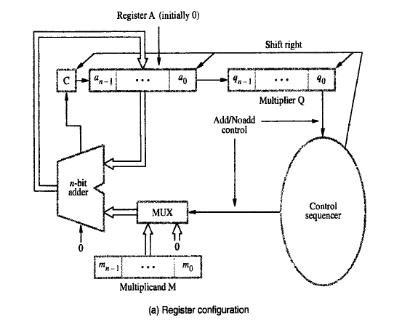
Sequential Circuit Multiplier
Illustrate a sequential circuit binary multiplier with a neat diagram.
Figure shows the Hardware arrangement for sequential multiplication
Procedure for multiplication:
Multiplier is loaded into register Q, Multiplicand is loaded into register M
C & A are cleared to 0
Registers A and Q combined hold PPi(partial product)
Multiplier bit qi generates the signal Add/Noadd.
Single n-bit adder is used n times
DEPARTMENT OF COMPUTER SCIENCE AND ENGINEERING

Slide 44
Sequential Circuit Multiplier
If q0=1, add M to A and store sum in A.
The carry-out from the adder is stored in flip-flop C
Then C, A and Q are shifted right one bit-position.
If q0=0, no addition performed and C, A & Q are shifted right one bit-position.
After n cycles, the high-order half of the product is held in register A and the low-order half is held in register Q.
DEPARTMENT OF COMPUTER SCIENCE AND ENGINEERING

Slide 45
UNIT 2 – Arithmetic unit
Multiplication of two Numbers
A Signed Operand Multiplication
  Booth algorithm
Fast Multiplication
  Bit pair recoding
  Carry Save Addition(CSA)
Integer Division
IEEE standard for floating point numbers
DEPARTMENT OF COMPUTER SCIENCE AND ENGINEERING

Slide 46
Signed Multiplication
Multiplication of 2’s complement signed operands, generating a double length product
  Case1 :
  Positive Multiplier and Negative multiplicand, When we add a negative multiplicand to a partial
  product , we must extend sign-bit value of the multiplicand to the left as far as the product will
  extend.
  Case2:
  For a negative multiplier, a straightforward solution is to form the 2’s-complement of both the
  multiplier and the multiplicand and proceed as in the case of a positive multiplier.
A technique that works equally well for both negative and positive multipliers – Booth algorithm.
DEPARTMENT OF COMPUTER SCIENCE AND ENGINEERING
Notes:
‹#›

Slide 47
Signed Multiplication
Considering 2’s-complement signed operands, what will happen to (-13)×(+11) if following the same method of unsigned multiplication?
1
0
0
1
1
(
-
13
)
0
1
0
1
1
(
+
11
)
1
1
1
1
1
1
0
0
1
1
1
1
1
1
1
0
0
1
1
Sign extension is
0
0
0
0
0
0
0
0
shown in blue
1
1
1
0
0
1
1
0
0
0
0
0
0
1
1
0
1
1
1
0
0
0
1
(
-
143
)
Sign extension of negative multiplicand.
DEPARTMENT OF COMPUTER SCIENCE AND ENGINEERING
Notes:
‹#›

Slide 48
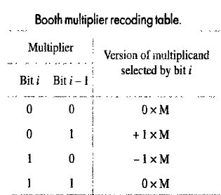
Booth Algorithm
Booths recoding scheme
  Multiplier is scanned from right to left
1 | 1 | 0 | 1 | 0 | 0
0 | -1 | +1 | -1 | 0
DEPARTMENT OF COMPUTER SCIENCE AND ENGINEERING
Notes:
‹#›

Slide 49
Booth Algorithm
Recode the multiplier 101100
1 | 0 | 1 | 1 | 0 | 0 | 0
-1 | +1 | 0 | -1 | 0 | 0
DEPARTMENT OF COMPUTER SCIENCE AND ENGINEERING
Notes:
‹#›

Slide 50
Booth Algorithm
Compute +13 x -6 using Booth algorithm
Booth multiplication with a negative multiplier.
0
1
1
0
1
0
-
1
+1
-
1
0
0
1
1
0
1
(
+
13
)
0
0
0
0
0
0
0
0
0
0
X
1
1
0
1
0
(
-
6
)
1
1
1
1
1
0
0
1
1
0
0
0
0
1
1
0
1
1
1
1
0
0
1
1
0
0
0
0
0
0
1
1
1
0
1
1
0
0
1
0
(
-
78
)
DEPARTMENT OF COMPUTER SCIENCE AND ENGINEERING
Notes:
‹#›

Slide 51
Booth Algorithm
2
13
2
6
2
6
1
2
3
0
2
3
0
1
1
1
Represent in Binary form
M= +13 |  |  | 1 | 1 | 0 | 1
Q= -6 |  |  | 0 | 1 | 1 | 0
1
1
-6 = 2’s complement
0 1 1 0
0 0 1
1
1 0 1 0
2
Take 2’s complement of Negative value
M= +13 |  |  | 1 | 1 | 0 | 1
Q= -6 |  |  | 1 | 0 | 1 | 0
3
Add Sign bit
M= +13 |  | 0 | 1 | 1 | 0 | 1
Q= -6 |  | 1 | 1 | 0 | 1 | 0
4
Recode Multiplier
Q= -6 | 1 | 1 | 0 | 1 | 0
 | 0 | -1 | +1 | -1 | 0
0
DEPARTMENT OF COMPUTER SCIENCE AND ENGINEERING
Notes:
‹#›

Slide 52
Booth Algorithm
M |  |  |  |  |  |  | 0 | 1 | 1 | 0 | 1
Q |  |  |  |  |  |  | 0 | -1 | 1 | -1 | 0
 |  |  |  |  |  |  | 0 | 0 | 0 | 0 | 0
P
DEPARTMENT OF COMPUTER SCIENCE AND ENGINEERING

Slide 53
Booth Algorithm
M |  |  |  |  |  |  | 0 | 1 | 1 | 0 | 1
Q |  |  |  |  |  |  | 0 | -1 | 1 | -1 | 0
 |  | 0 | 0 | 0 | 0 | 0 | 0 | 0 | 0 | 0 | 0
P
DEPARTMENT OF COMPUTER SCIENCE AND ENGINEERING

Slide 54
Booth Algorithm
M |  |  |  |  |  |  | 0 | 1 | 1 | 0 | 1
Q |  |  |  |  |  |  | 0 | -1 | 1 | -1 | 0
 |  | 0 | 0 | 0 | 0 | 0 | 0 | 0 | 0 | 0 | 0
 |  |  |  |  |  | 1 | 0 | 0 | 1 | 1
P
+13 = 2’s complement
0 1 1 0 1
0 0 1 0
1
1 0 0 1 1
DEPARTMENT OF COMPUTER SCIENCE AND ENGINEERING

Slide 55
Booth Algorithm
M |  |  |  |  |  |  | 0 | 1 | 1 | 0 | 1
Q |  |  |  |  |  |  | 0 | -1 | 1 | -1 | 0
 |  | 0 | 0 | 0 | 0 | 0 | 0 | 0 | 0 | 0 | 0
 |  | 1 | 1 | 1 | 1 | 1 | 0 | 0 | 1 | 1
P
+13 = 2’s complement
0 1 1 0 1
0 0 1 0
1
1 0 0 1 1
DEPARTMENT OF COMPUTER SCIENCE AND ENGINEERING

Slide 56
Booth Algorithm
M |  |  |  |  |  |  | 0 | 1 | 1 | 0 | 1
Q |  |  |  |  |  |  | 0 | -1 | 1 | -1 | 0
 |  | 0 | 0 | 0 | 0 | 0 | 0 | 0 | 0 | 0 | 0
 |  | 1 | 1 | 1 | 1 | 1 | 0 | 0 | 1 | 1
 |  |  |  |  | 0 | 1 | 1 | 0 | 1
P
DEPARTMENT OF COMPUTER SCIENCE AND ENGINEERING

Slide 57
Booth Algorithm
M |  |  |  |  |  |  | 0 | 1 | 1 | 0 | 1
Q |  |  |  |  |  |  | 0 | -1 | 1 | -1 | 0
 |  | 0 | 0 | 0 | 0 | 0 | 0 | 0 | 0 | 0 | 0
 |  | 1 | 1 | 1 | 1 | 1 | 0 | 0 | 1 | 1
 |  | 0 | 0 | 0 | 0 | 1 | 1 | 0 | 1
P
DEPARTMENT OF COMPUTER SCIENCE AND ENGINEERING

Slide 58
Booth Algorithm
M |  |  |  |  |  |  | 0 | 1 | 1 | 0 | 1
Q |  |  |  |  |  |  | 0 | -1 | 1 | -1 | 0
 |  | 0 | 0 | 0 | 0 | 0 | 0 | 0 | 0 | 0 | 0
 |  | 1 | 1 | 1 | 1 | 1 | 0 | 0 | 1 | 1
 |  | 0 | 0 | 0 | 0 | 1 | 1 | 0 | 1
 |  |  |  | 1 | 0 | 0 | 1 | 1
P
+13 = 2’s complement
0 1 1 0 1
0 0 1 0
1
1 0 0 1 1
DEPARTMENT OF COMPUTER SCIENCE AND ENGINEERING

Slide 59
Booth Algorithm
M |  |  |  |  |  |  | 0 | 1 | 1 | 0 | 1
Q |  |  |  |  |  |  | 0 | -1 | 1 | -1 | 0
 |  | 0 | 0 | 0 | 0 | 0 | 0 | 0 | 0 | 0 | 0
 |  | 1 | 1 | 1 | 1 | 1 | 0 | 0 | 1 | 1
 |  | 0 | 0 | 0 | 0 | 1 | 1 | 0 | 1
 |  | 1 | 1 | 1 | 0 | 0 | 1 | 1
P
+13 = 2’s complement
0 1 1 0 1
0 0 1 0
1
1 0 0 1 1
DEPARTMENT OF COMPUTER SCIENCE AND ENGINEERING

Slide 60
Booth Algorithm
M |  |  |  |  |  |  | 0 | 1 | 1 | 0 | 1
Q |  |  |  |  |  |  | 0 | -1 | 1 | -1 | 0
 |  | 0 | 0 | 0 | 0 | 0 | 0 | 0 | 0 | 0 | 0
 |  | 1 | 1 | 1 | 1 | 1 | 0 | 0 | 1 | 1
 |  | 0 | 0 | 0 | 0 | 1 | 1 | 0 | 1
 |  | 1 | 1 | 1 | 0 | 0 | 1 | 1
 |  |  | 0 | 0 | 0 | 0 | 0
P
DEPARTMENT OF COMPUTER SCIENCE AND ENGINEERING

Slide 61
Booth Algorithm
M |  |  |  |  |  |  | 0 | 1 | 1 | 0 | 1
Q |  |  |  |  |  |  | 0 | -1 | 1 | -1 | 0
 |  | 0 | 0 | 0 | 0 | 0 | 0 | 0 | 0 | 0 | 0
 |  | 1 | 1 | 1 | 1 | 1 | 0 | 0 | 1 | 1
 |  | 0 | 0 | 0 | 0 | 1 | 1 | 0 | 1
 |  | 1 | 1 | 1 | 0 | 0 | 1 | 1
 |  | 0 | 0 | 0 | 0 | 0 | 0
P
DEPARTMENT OF COMPUTER SCIENCE AND ENGINEERING

Slide 62
Booth Algorithm
M |  |  |  |  |  |  | 0 | 1 | 1 | 0 | 1
Q |  |  |  |  |  |  | 0 | -1 | 1 | -1 | 0
 |  | 1 | 1 | 1 | 1 | 1 | 1 | 1
 |  | 0 | 0 | 0 | 0 | 0 | 0 | 0 | 0 | 0 | 0
 |  | 1 | 1 | 1 | 1 | 1 | 0 | 0 | 1 | 1
 |  | 0 | 0 | 0 | 0 | 1 | 1 | 0 | 1
 |  | 1 | 1 | 1 | 0 | 0 | 1 | 1
 |  | 0 | 0 | 0 | 0 | 0 | 0
P | 1 | 1 | 1 | 1 | 0 | 1 | 1 | 0 | 0 | 1 | 0
1 + 1 | = | 10
1+1+1 | = | 11
1+1+1+1 | = | 100
1+1+1+1+1 | = | 101
1+1+1+1+1+1 | = | 110
Carry ignore
DEPARTMENT OF COMPUTER SCIENCE AND ENGINEERING

Slide 63
Booth Algorithm
A |  |  |  |  |  |  |  | 0 | 1 | 0 | 1 | 1 | 1
B |  |  |  |  |  |  |  | 0 | -1 | +1 | 0 | -1 | 0
 |  | 0 | 0 | 0 | 0 | 0 | 0 | 0 | 0 | 0 | 0 | 0 | 0
 |  | 1 | 1 | 1 | 1 | 1 | 1 | 0 | 1 | 0 | 0 | 1
 |  | 0 | 0 | 0 | 0 | 0 | 0 | 0 | 0 | 0 | 0
 |  | 0 | 0 | 0 | 0 | 1 | 0 | 1 | 1 | 1
 |  | 1 | 1 | 1 | 0 | 1 | 0 | 0 | 1
 |  | 0 | 0 | 0 | 0 | 0 | 0 | 0
P
2. Multiply each of the following pairs of signed 2’s complement numbers using booth algorithm (Assume A is the Multiplicand and B is the Multiplier)
A = 010111 B = 110110
Q= | 1 | 1 | 0 | 1 | 1 | 0
 | 0 | -1 | +1 | 0 | -1 | 0
0
DEPARTMENT OF COMPUTER SCIENCE AND ENGINEERING

Slide 64
Booth Algorithm
A |  |  |  |  |  |  |  | 0 | 1 | 0 | 1 | 1 | 1
B |  |  |  |  |  |  |  | 0 | -1 | +1 | 0 | -1 | 0
 |  | 1 | 1 | 1 | 0 | 1 | 1 | 1
 |  | 0 | 0 | 0 | 0 | 0 | 0 | 0 | 0 | 0 | 0 | 0 | 0
 |  | 1 | 1 | 1 | 1 | 1 | 1 | 0 | 1 | 0 | 0 | 1
 |  | 0 | 0 | 0 | 0 | 0 | 0 | 0 | 0 | 0 | 0
 |  | 0 | 0 | 0 | 0 | 1 | 0 | 1 | 1 | 1
 |  | 1 | 1 | 1 | 0 | 1 | 0 | 0 | 1
 |  | 0 | 0 | 0 | 0 | 0 | 0 | 0
P | 1 | 1 | 1 | 1 | 1 | 0 | 0 | 0 | 1 | 1 | 0 | 1 | 0
1 + 1 | = | 10
1+1+1 | = | 11
1+1+1+1 | = | 100
1+1+1+1+1 | = | 101
1+1+1+1+1+1 | = | 110
Carry ignore
DEPARTMENT OF COMPUTER SCIENCE AND ENGINEERING

Slide 65
Examples for Booth Algorithm
Compute 45 x -24 using Booth algorithm
Compute -13 x -20 using Booth algorithm
Computer -13 x +9 using Booth algorithm
Computer 14 x -8 using Booth algorithm
Multiply each of the following pairs of signed 2’s complement numbers using booth algorithm (Assume A is the Multiplicand and B is the Multiplier)
    A = 110011 B = 101100
    A = 110101 B = 011011
    A = 001111 B = 001111
    A = 10101 B = 10101
DEPARTMENT OF COMPUTER SCIENCE AND ENGINEERING

Slide 66
UNIT 2 – Arithmetic unit
Multiplication of two Numbers
A Signed Operand Multiplication
  Booth algorithm
Fast Multiplication
  Bit-Pair algorithm
  Carry Save Addition(CSA)
Integer Division
IEEE standard for floating point numbers
DEPARTMENT OF COMPUTER SCIENCE AND ENGINEERING

Slide 67
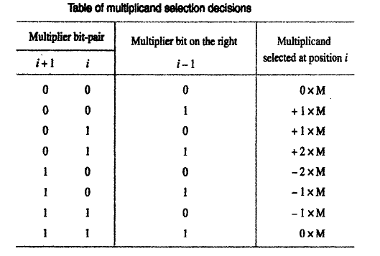
Bit-Pair algorithm
Bit-pair recoding halves the maximum number of summands (versions of the multiplicand).
Sign extension
Implied 0 to right of LSB
1
1
1
0
1
0
0
0
0
−
1
+
1
−
1
0
0
−
1
−
2
(a) Example of bit-pair recoding derived from Booth recoding
DEPARTMENT OF COMPUTER SCIENCE AND ENGINEERING
Notes:
‹#›

Slide 68
Bit-Pair algorithm
Recode the multiplier 101100
1 | 0 | 1 | 1 | 0 | 0 | 0
 | -1 |  | -1 |  | 0
DEPARTMENT OF COMPUTER SCIENCE AND ENGINEERING
Notes:
‹#›

Slide 69
Bit-Pair algorithm
Recode the multiplier 011011
0 | 1 | 1 | 0 | 1 | 1 | 0
 | +2 |  | -1 |  | -1
DEPARTMENT OF COMPUTER SCIENCE AND ENGINEERING
Notes:
‹#›

Slide 70
Bit-Pair algorithm
Recode the multiplier 1 1 0 1 0
Add sign extended bit
1 | 1 | 1 | 0 | 1 | 0 | 0
 | 0 |  | -1 |  | -2
DEPARTMENT OF COMPUTER SCIENCE AND ENGINEERING
Notes:
‹#›

Slide 71
Bit-Pair algorithm
0
1
1
0
1
0
-
1
+
1
-
1
0
0
0
0
0
0
0
0
0
0
0
1
1
1
1
1
0
0
1
1
0
0
0
0
1
1
0
1
1
1
1
0
0
1
1
0
1
1
0
1
(
+
13
)
0
0
0
0
0
0
×
1
1
0
1
0
(
-
6
)
1
1
1
0
1
1
0
0
1
0
(
-
78
)
0
1
1
0
1
0
-
1
-
2
1
1
1
1
1
0
0
1
1
0
1
1
1
1
0
0
1
1
0
0
0
0
0
0
1
1
1
0
1
1
0
0
1
0
DEPARTMENT OF COMPUTER SCIENCE AND ENGINEERING
Notes:
‹#›

Slide 72
Bit-Pair algorithm
2
13
2
6
2
6
1
2
3
0
2
3
0
1
1
1. Compute +13 x -6 using Bit Pair Recoding technique.
1
1
1
Represent in Binary form
M= +13 |  |  | 1 | 1 | 0 | 1
Q= -6 |  |  | 0 | 1 | 1 | 0
-6 = 2’s complement
0 1 1 0
0 0 1
1
1 0 1 0
2
Take 2’s complement of Negative value
M= +13 |  |  | 1 | 1 | 0 | 1
Q= -6 |  |  | 1 | 0 | 1 | 0
4
Recode Multiplier
1 | 1 | 1 | 0 | 1 | 0
 | 0 |  | -1 |  | -2
0
3
Add Sign bit
M= +13 |  | 0 | 1 | 1 | 0 | 1
Q= -6 |  | 1 | 1 | 0 | 1 | 0
DEPARTMENT OF COMPUTER SCIENCE AND ENGINEERING
Notes:
‹#›

Slide 73
Bit-Pair algorithm
M |  |  |  |  |  |  |  | 0 | 1 | 1 | 0 | 1
Q |  |  |  |  |  |  |  | 0 |  | -1 |  | -2
 |  |  | 1 | 1 | 1 | 1 | 1 | 0 | 0 | 1 | 1 | 0
P
If Multiplier bit is -2, take 2’s complement of Multiplicand and then multiply with 10
  M= 0 1 1 0 1
  1 0 0 1 0
  1
  1 0 0 1 1 X 1 0
  0 0 0 0 0
  0 0 1 1
  1 0 0 1 1 0
DEPARTMENT OF COMPUTER SCIENCE AND ENGINEERING

Slide 74
Bit-Pair algorithm
M |  |  |  |  |  |  |  | 0 | 1 | 1 | 0 | 1
Q |  |  |  |  |  |  |  | 0 |  | -1 |  | -2
 |  |  | 1 | 1 | 1 | 1 | 1 | 0 | 0 | 1 | 1 | 0
 |  |  | 1 | 1 | 1 | 1 | 0 | 0 | 1 | 1
P
If Multiplier bit is -1, take 2’s complement of Multiplicand
  M= 0 1 1 0 1
  1 0 0 1 0
  1
  1 0 0 1 1
DEPARTMENT OF COMPUTER SCIENCE AND ENGINEERING

Slide 75
Bit-Pair algorithm
M |  |  |  |  |  |  |  | 0 | 1 | 1 | 0 | 1
Q |  |  |  |  |  |  |  | 0 |  | -1 |  | -2
 |  |  | 1 | 1 | 1 | 1 | 1 | 0 | 0 | 1 | 1 | 0
 |  |  | 1 | 1 | 1 | 1 | 0 | 0 | 1 | 1
 |  |  | 0 | 0 | 0 | 0 | 0 | 0
P
If Multiplier bit is 0, then 0 X M
DEPARTMENT OF COMPUTER SCIENCE AND ENGINEERING

Slide 76
Bit-Pair algorithm
M |  |  |  |  |  |  | 0 | 1 | 1 | 0 | 1
Q |  |  |  |  |  |  | 0 |  | -1 |  | -2
 | 1 | 1 | 1 | 1 |  |  | 1 | 1
 |  | 1 | 1 | 1 | 1 | 1 | 0 | 0 | 1 | 1 | 0
 |  | 1 | 1 | 1 | 1 | 0 | 0 | 1 | 1
 |  | 0 | 0 | 0 | 0 | 0 | 0
P | 1 | 1 | 1 | 1 | 0 | 1 | 1 | 0 | 0 | 1 | 0
If Multiplier bit is 0, then 0 X M
Carry ignore
DEPARTMENT OF COMPUTER SCIENCE AND ENGINEERING

Slide 77
Bit-Pair algorithm
Compute -11 x +27 using Bit Pair Recoding technique.
-11 = 2’s complement
0 1 0 1 1
1 0 1 0 0
1
1 0 1 0 1
M= -11 |  | 0 | 1 | 0 | 1 | 1
Q= 27 |  | 1 | 1 | 0 | 1 | 1
1
Represent in Binary form
2
Take 2’s complement of Negative value
M= -11 |  | 1 | 0 | 1 | 0 | 1
Q= 27
4
Recode Multiplier
0 | 1 | 1 | 0 | 1 | 1
 | +2 |  | -1 |  | -1
0
3
Add Sign bit
M= -11 | 1 | 1 | 0 | 1 | 0 | 1
Q= 27 | 0 | 1 | 1 | 0 | 1 | 1
DEPARTMENT OF COMPUTER SCIENCE AND ENGINEERING
Notes:
‹#›

Slide 78
Bit-Pair algorithm
M |  |  |  |  |  |  | 1 | 1 | 0 | 1 | 0 | 1
Q |  |  |  |  |  |  |  | +2 |  | -1 |  | -1
 |  |  |  |  |  |  | 0 | 0 | 1 | 0 | 1 | 1
P
If Multiplier bit is -1, take 2’s complement of Multiplicand
1 1 0 1 0 1
0 0 1 0 1 0
1
0 0 1 0 1 1
DEPARTMENT OF COMPUTER SCIENCE AND ENGINEERING

Slide 79
Bit-Pair algorithm
M |  |  |  |  |  |  | 1 | 1 | 0 | 1 | 0 | 1
Q |  |  |  |  |  |  |  | +2 |  | -1 |  | -1
 | 0 | 0 | 0 | 0 | 0 | 0 | 0 | 0 | 1 | 0 | 1 | 1
P
If Multiplier bit is -1, take 2’s complement of Multiplicand
1 1 0 1 0 1
0 0 1 0 1 0
1
0 0 1 0 1 1
DEPARTMENT OF COMPUTER SCIENCE AND ENGINEERING

Slide 80
Bit-Pair algorithm
M |  |  |  |  |  |  | 1 | 1 | 0 | 1 | 0 | 1
Q |  |  |  |  |  |  |  | +2 |  | -1 |  | -1
 | 0 | 0 | 0 | 0 | 0 | 0 | 0 | 0 | 1 | 0 | 1 | 1
 | 0 | 0 | 0 | 0 | 0 | 0 | 1 | 0 | 1 | 1
P
If Multiplier bit is -1, take 2’s complement of Multiplicand
1 1 0 1 0 1
0 0 1 0 1 0
1
0 0 1 0 1 1
DEPARTMENT OF COMPUTER SCIENCE AND ENGINEERING

Slide 81
Bit-Pair algorithm
M |  |  |  |  |  |  | 1 | 1 | 0 | 1 | 0 | 1
Q |  |  |  |  |  |  |  | +2 |  | -1 |  | -1
 | 0 | 0 | 0 | 0 | 0 | 0 | 0 | 0 | 1 | 0 | 1 | 1
 | 0 | 0 | 0 | 0 | 0 | 0 | 1 | 0 | 1 | 1
 |  | 1 | 1 | 0 | 1 | 0 | 1 | 0
P
If Multiplier bit is +2, multiply the multiplicand with 10
  M= 1 1 0 1 0 1 X 1 0
  0 0 0 0 0 0
  1 1 0 1 0 1
  1 1 0 1 0 1 0
DEPARTMENT OF COMPUTER SCIENCE AND ENGINEERING

Slide 82
Bit-Pair algorithm
M |  |  |  |  |  |  | 1 | 1 | 0 | 1 | 0 | 1
Q |  |  |  |  |  |  |  | +2 |  | -1 |  | -1
 | 0 | 0 | 0 | 0 | 0 | 0 | 0 | 0 | 1 | 0 | 1 | 1
 | 0 | 0 | 0 | 0 | 0 | 0 | 1 | 0 | 1 | 1
 | 1 | 1 | 1 | 0 | 1 | 0 | 1 | 0
P
If Multiplier bit is +2, multiply the multiplicand with 10
  M= 1 1 0 1 0 1 X 1 0
  0 0 0 0 0 0
  1 1 0 1 0 1
  1 1 0 1 0 1 0
DEPARTMENT OF COMPUTER SCIENCE AND ENGINEERING

Slide 83
Bit-Pair algorithm
M |  |  |  |  |  |  | 1 | 1 | 0 | 1 | 0 | 1
Q |  |  |  |  |  |  |  | +2 |  | -1 |  | -1
 |  |  |  |  |  | 1 |  | 1
 | 0 | 0 | 0 | 0 | 0 | 0 | 0 | 0 | 1 | 0 | 1 | 1
 | 0 | 0 | 0 | 0 | 0 | 0 | 1 | 0 | 1 | 1
 | 1 | 1 | 1 | 0 | 1 | 0 | 1 | 0
P | 1 | 1 | 1 | 0 | 1 | 1 | 0 | 1 | 0 | 1 | 1 | 1
If Multiplier bit is +2, multiply the multiplicand with 10
  M= 1 1 0 1 0 1 X 1 0
  0 0 0 0 0 0
  1 1 0 1 0 1
  1 1 0 1 0 1 0
DEPARTMENT OF COMPUTER SCIENCE AND ENGINEERING

Slide 84
Examples for Bit-Pair Recoding Technique
Compute -87 X -35 using Bit Pair Recoding technique.
Write Booth multiplier recoding table and explain good, ordinary and worst-case multiplier with suitable examples.
Solve using Bit Pair Recoding technique
  i)-14 X -5
  ii) 12 X -4
  iii) 45 X -24
  iv) -32 X -15
4. Multiply each of the following pairs of signed 2’s complement numbers using bit pairing of the multiplier (Assume A is the Multiplicand and B is the Multiplier)
  i) A=010111 B=110110
  ii) A=110011 B=101100.
DEPARTMENT OF COMPUTER SCIENCE AND ENGINEERING

Slide 85
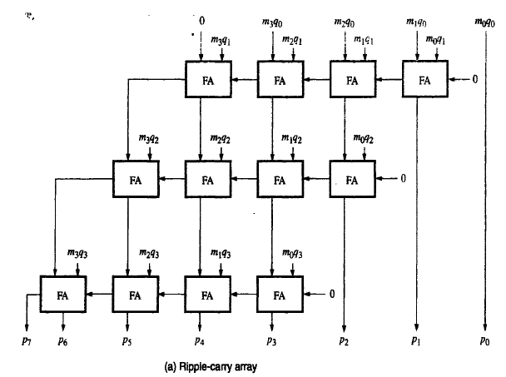
Carry-Save Addition(CSA) of Summands
Multiplication requires the addition of several summands
CSA speeds up the addition process
Consider the array for 4 x 4 multiplication
DEPARTMENT OF COMPUTER SCIENCE AND ENGINEERING
Notes:
‹#›

Slide 86
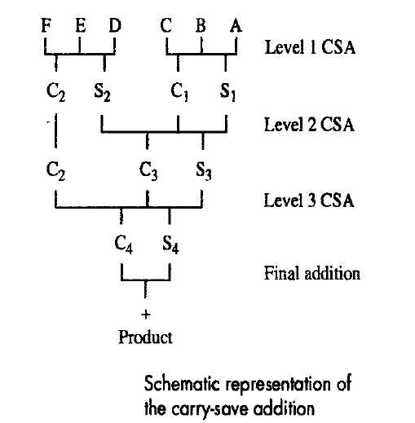
Carry-Save Addition of Summands
Consider the addition of many summands:
Group the summands in threes and perform carry-save addition on each of these groups in parallel to generate a set of S and C vectors in one full-adder delay
Group all of the S and C vectors into threes, and perform carry-save addition on them, generating a further set of S and C vectors in one more full-adder delay
Continue with this process until there are only two vectors remaining
They can be added in a RCA or CLA to produce the desired product
DEPARTMENT OF COMPUTER SCIENCE AND ENGINEERING
Notes:
‹#›

Slide 87
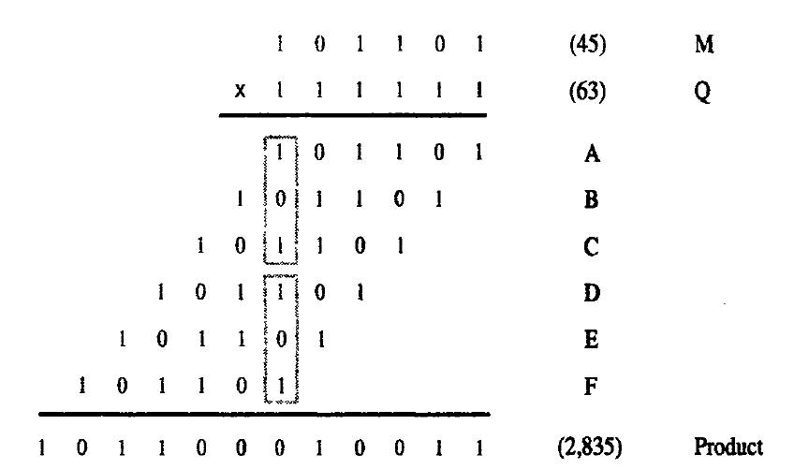
Carry-Save Addition(CSA) of Summands
1 + 1 | = | 10
1+1+1 | = | 11
1+1+1+1 | = | 100
1+1+1+1+1 | = | 101
1+1+1+1+1+1 | = | 110
DEPARTMENT OF COMPUTER SCIENCE AND ENGINEERING

Slide 88
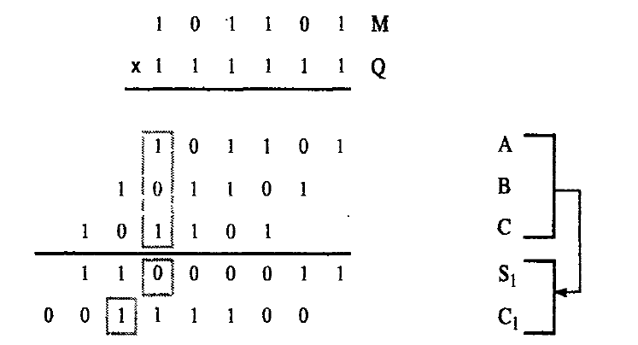
Carry-Save Addition(CSA) of Summands
DEPARTMENT OF COMPUTER SCIENCE AND ENGINEERING

Slide 89
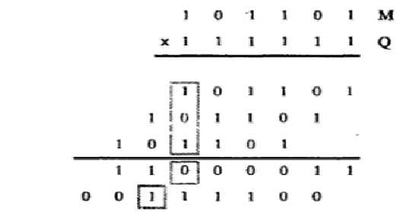
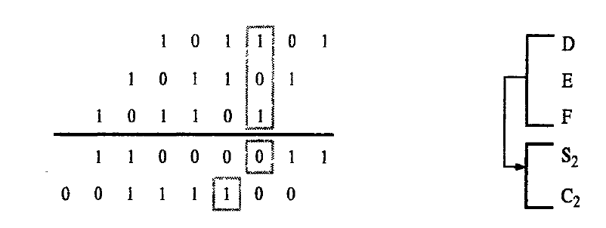
Carry-Save Addition(CSA) of Summands
DEPARTMENT OF COMPUTER SCIENCE AND ENGINEERING

Slide 90
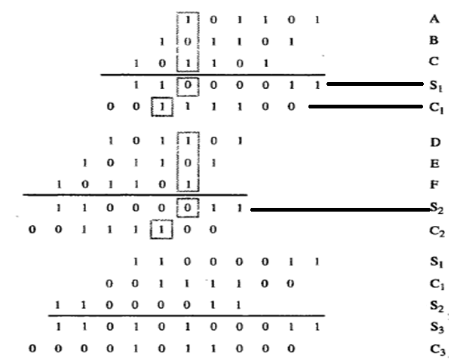
Carry-Save Addition(CSA) of Summands

Slide 91
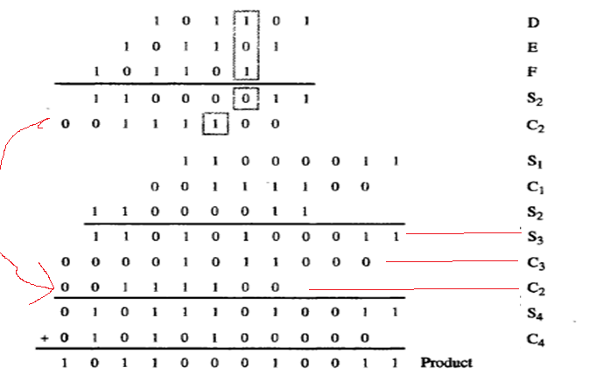
Carry-Save Addition(CSA) of Summands
DEPARTMENT OF COMPUTER SCIENCE AND ENGINEERING

Slide 92
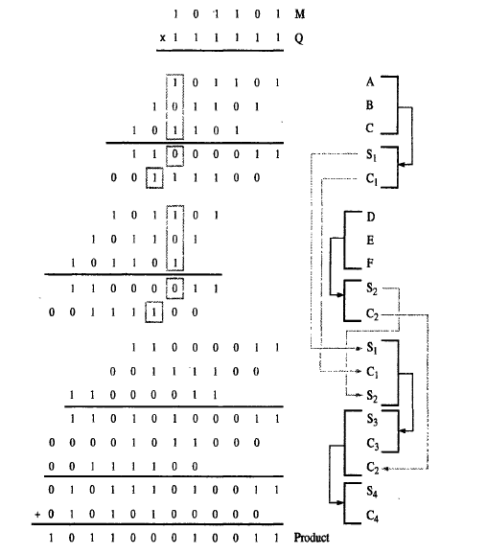
Carry-Save Addition(CSA) of Summands

Slide 93
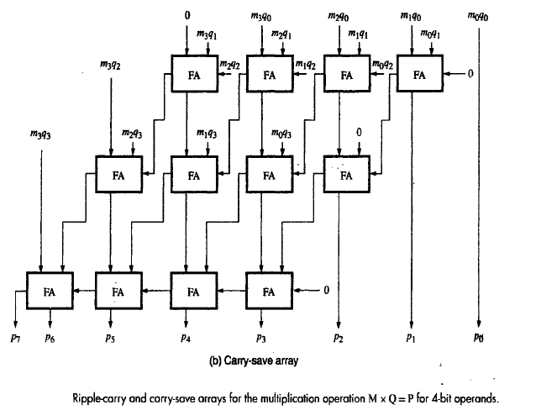
Carry-Save Addition(CSA) of Summands
DEPARTMENT OF COMPUTER SCIENCE AND ENGINEERING
Notes:
‹#›

Slide 94
Examples for CSA
Write the schematic representation of carry save addition and perform 47 x 60 using CSA
Illustrate the working of CSA with 45 and 63 as the Multiplicand and Multiplier respectively.
DEPARTMENT OF COMPUTER SCIENCE AND ENGINEERING

Slide 95
UNIT 2 – Arithmetic unit
Multiplication of two Numbers
A Signed Operand Multiplication
  Booth algorithm
Fast Multiplication
  Bit pair recoding
  Carry Save Addition(CSA)
Integer Division
  Restoring Division
  Nonrestoring Division
IEEE standard for floating point numbers
DEPARTMENT OF COMPUTER SCIENCE AND ENGINEERING

Slide 96
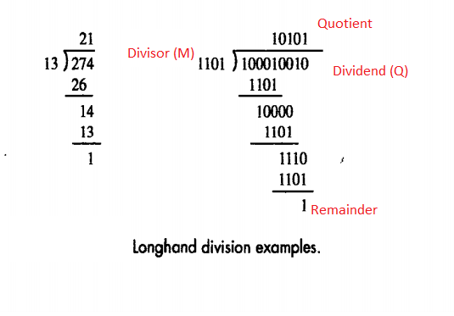
Integer Division
DEPARTMENT OF COMPUTER SCIENCE AND ENGINEERING
Notes:
‹#›

Slide 97
Algorithm to perform restoring division
  Initialize Register A = n+1 bits with 0’s and Register Q with Dividend bits and M with Divisor bits, Count = n
  Shift A and Q left one binary position
  Subtract M from A, and place the answer back in A ( A = A-M)
  Observe the sign bit of A
        If the sign bit of A is 1, set q₀ = 0 and add M back to A( A=A+M) restoration is done
        If the sign bit of A is 0, set q₀ = 1 ,norestoration is done
  Count = Count – 1
  6. Repeat step 2,3,4,5 until count = 0
DEPARTMENT OF COMPUTER SCIENCE AND ENGINEERING

Slide 98

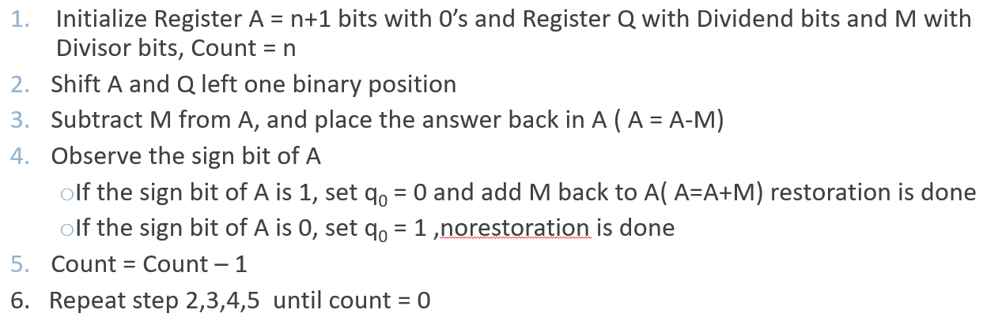
Compute 10/3 using restoring division
1 | 1 | 0 | 1
Dividend Q=10
Divisor M=3
0 | 0 | 1 | 1
A
Q
0 | 0 | 0 | 0 | 0
1 | 0 | 1 | 0
M
0 | 0 | 0 | 1 | 1
DEPARTMENT OF COMPUTER SCIENCE AND ENGINEERING

Slide 99
Compute 10/3 using restoring division
1 | 1 | 0 | 1
Dividend Q=10
Divisor M=3
0 | 0 | 1 | 1
Count =4
A
Q
0 | 0 | 0 | 0 | 0
1 | 0 | 1 | 0
M
0 | 0 | 0 | 1 | 1
Shift
0 | 0 | 0 | 0 | 1
0 | 1 | 0
DEPARTMENT OF COMPUTER SCIENCE AND ENGINEERING

Slide 100
Compute 10/3 using restoring division
1 | 1 | 0 | 1
Dividend Q=10
Divisor M=3
0 | 0 | 1 | 1
Count =4
A
Q
0 | 0 | 0 | 0 | 0
1 | 0 | 1 | 0
M
0 | 0 | 0 | 1 | 1
Shift
Subtract
0 | 0 | 0 | 0 | 1
1 | 1 | 1 | 0 | 1
0 | 1 | 0
2’s complement of M
M = 0 0 0 1 1
1 1 1 0 0
1
1 1 1 0 1
DEPARTMENT OF COMPUTER SCIENCE AND ENGINEERING

Slide 101
Compute 10/3 using restoring division
1 | 1 | 0 | 1
Dividend Q=10
Divisor M=3
0 | 0 | 1 | 1
Count =4
A
Q
0 | 0 | 0 | 0 | 0
1 | 0 | 1 | 0
M
0 | 0 | 0 | 1 | 1
Shift
Subtract
0 | 0 | 0 | 0 | 1
1 | 1 | 1 | 0 | 1
1 | 1 | 1 | 1 | 0
0 | 1 | 0
DEPARTMENT OF COMPUTER SCIENCE AND ENGINEERING

Slide 102
Compute 10/3 using restoring division
1 | 1 | 0 | 1
Dividend Q=10
Divisor M=3
0 | 0 | 1 | 1
Count =4
A
Q
0 | 0 | 0 | 0 | 0
1 | 0 | 1 | 0
M
0 | 0 | 0 | 1 | 1
Shift
Subtract
Set q0
0 | 0 | 0 | 0 | 1
1 | 1 | 1 | 0 | 1
1 | 1 | 1 | 1 | 0
0 | 1 | 0
0 | 1 | 0 | 0
DEPARTMENT OF COMPUTER SCIENCE AND ENGINEERING

Slide 103
Compute 10/3 using restoring division
1 | 1 | 0 | 1
Dividend Q=10
Divisor M=3
0 | 0 | 1 | 1
Count =4
A
Q
0 | 0 | 0 | 0 | 0
1 | 0 | 1 | 0
M
0 | 0 | 0 | 1 | 1
Shift
Subtract
Set q0
Restore
0 | 0 | 0 | 0 | 1
1 | 1 | 1 | 0 | 1
1 | 1 | 1 | 1 | 0
0 | 0 | 0 | 0 | 1
0 | 1 | 0
M 0 0 0 1 1
A 1 1 1 1 0
A+M 1 0 0 0 0 1
1
0 | 1 | 0 | 0
DEPARTMENT OF COMPUTER SCIENCE AND ENGINEERING

Slide 104
Compute 10/3 using restoring division
1 | 1 | 0 | 1
Dividend Q=10
Divisor M=3
0 | 0 | 1 | 1
Count = 3
A
Q
0 | 0 | 0 | 0 | 1
0 | 1 | 0 | 0
M
0 | 0 | 0 | 1 | 1
Shift
0 | 0 | 0 | 1 | 0
1 | 0 | 0
DEPARTMENT OF COMPUTER SCIENCE AND ENGINEERING

Slide 105
Compute 10/3 using restoring division
1 | 1 | 0 | 1
Dividend Q=10
Divisor M=3
0 | 0 | 1 | 1
Count =3
A
Q
0 | 0 | 0 | 0 | 1
0 | 1 | 0 | 0
M
0 | 0 | 0 | 1 | 1
Shift
Subtract
0 | 0 | 0 | 1 | 0
1 | 1 | 1 | 0 | 1
1 | 0 | 0
2’s complement of M
M = 0 0 0 1 1
1 1 1 0 0
1
1 1 1 0 1
DEPARTMENT OF COMPUTER SCIENCE AND ENGINEERING

Slide 106
Compute 10/3 using restoring division
1 | 1 | 0 | 1
Dividend Q=10
Divisor M=3
0 | 0 | 1 | 1
Count =3
A
Q
0 | 0 | 0 | 0 | 1
0 | 1 | 0 | 0
M
0 | 0 | 0 | 1 | 1
Shift
Subtract
0 | 0 | 0 | 1 | 0
1 | 1 | 1 | 0 | 1
1 | 1 | 1 | 1 | 1
1 | 0 | 0
DEPARTMENT OF COMPUTER SCIENCE AND ENGINEERING

Slide 107
Compute 10/3 using restoring division
1 | 1 | 0 | 1
Dividend Q=10
Divisor M=3
0 | 0 | 1 | 1
Count =3
A
Q
0 | 0 | 0 | 0 | 1
0 | 1 | 0 | 0
M
0 | 0 | 0 | 1 | 1
Shift
Subtract
Set q0
0 | 0 | 0 | 1 | 0
1 | 1 | 1 | 0 | 1
1 | 1 | 1 | 1 | 1
1 | 0 | 0
1 | 0 | 0 | 0
DEPARTMENT OF COMPUTER SCIENCE AND ENGINEERING

Slide 108
Compute 10/3 using restoring division
1 | 1 | 0 | 1
Dividend Q=10
Divisor M=3
0 | 0 | 1 | 1
Count =3
A
Q
0 | 0 | 0 | 0 | 1
0 | 1 | 0 | 0
M
0 | 0 | 0 | 1 | 1
Shift
Subtract
Set q0
Restore
0 | 0 | 0 | 1 | 0
1 | 1 | 1 | 0 | 1
1 | 1 | 1 | 1 | 1
0 | 0 | 0 | 1 | 0
1 | 0 | 0
M 0 0 0 1 1
A 1 1 1 1 1
A+M 1 0 0 0 1 0
1
1 | 0 | 0 | 0
DEPARTMENT OF COMPUTER SCIENCE AND ENGINEERING

Slide 109
Compute 10/3 using restoring division
1 | 1 | 0 | 1
Dividend Q=10
Divisor M=3
0 | 0 | 1 | 1
Count =2
A
Q
0 | 0 | 0 | 1 | 0
1 | 0 | 0 | 0
M
0 | 0 | 0 | 1 | 1
Shift
0 | 0 | 1 | 0 | 1
0 | 0 | 0
DEPARTMENT OF COMPUTER SCIENCE AND ENGINEERING

Slide 110
Compute 10/3 using restoring division
1 | 1 | 0 | 1
Dividend Q=10
Divisor M=3
0 | 0 | 1 | 1
Count =2
A
Q
0 | 0 | 0 | 1 | 0
1 | 0 | 0 | 0
M
0 | 0 | 0 | 1 | 1
Shift
Subtract
0 | 0 | 1 | 0 | 1
1 | 1 | 1 | 0 | 1
0 | 0 | 0
2’s complement of M
M = 0 0 0 1 1
1 1 1 0 0
1
1 1 1 0 1
DEPARTMENT OF COMPUTER SCIENCE AND ENGINEERING

Slide 111
Compute 10/3 using restoring division
1 | 1 | 0 | 1
Dividend Q=10
Divisor M=3
0 | 0 | 1 | 1
Count =2
A
Q
0 | 0 | 0 | 1 | 0
1 | 0 | 0 | 0
M
0 | 0 | 0 | 1 | 1
Shift
Subtract
0 | 0 | 1 | 0 | 1
1 | 1 | 1 | 0 | 1
0 | 0 | 0 | 1 | 0
0 | 0 | 0
DEPARTMENT OF COMPUTER SCIENCE AND ENGINEERING

Slide 112
Compute 10/3 using restoring division
1 | 1 | 0 | 1
Dividend Q=10
Divisor M=3
0 | 0 | 1 | 1
Count =2
A
Q
0 | 0 | 0 | 1 | 0
1 | 0 | 0 | 0
M
0 | 0 | 0 | 1 | 1
Shift
Subtract
Set q0
0 | 0 | 1 | 0 | 1
1 | 1 | 1 | 0 | 1
0 | 0 | 0 | 1 | 0
0 | 0 | 0
1
0 | 0 | 0 | 1
DEPARTMENT OF COMPUTER SCIENCE AND ENGINEERING

Slide 113
Compute 10/3 using restoring division
1 | 1 | 0 | 1
Dividend Q=10
Divisor M=3
0 | 0 | 1 | 1
Count =2
A
Q
0 | 0 | 0 | 1 | 0
1 | 0 | 0 | 0
M
0 | 0 | 0 | 1 | 1
Shift
Subtract
Set q0
NoRestore
0 | 0 | 1 | 0 | 1
1 | 1 | 1 | 0 | 1
0 | 0 | 0 | 1 | 0
0 | 0 | 0
1
0 | 0 | 0 | 1
DEPARTMENT OF COMPUTER SCIENCE AND ENGINEERING

Slide 114
Compute 10/3 using restoring division
1 | 1 | 0 | 1
Dividend Q=10
Divisor M=3
0 | 0 | 1 | 1
Count =1
A
Q
0 | 0 | 0 | 1 | 0
0 | 0 | 0 | 1
M
0 | 0 | 0 | 1 | 1
Shift
0 | 0 | 1 | 0 | 0
0 | 0 | 1
DEPARTMENT OF COMPUTER SCIENCE AND ENGINEERING

Slide 115
Compute 10/3 using restoring division
1 | 1 | 0 | 1
Dividend Q=10
Divisor M=3
0 | 0 | 1 | 1
Count =1
A
Q
0 | 0 | 0 | 1 | 0
0 | 0 | 0 | 1
M
0 | 0 | 0 | 1 | 1
Shift
Subtract
0 | 0 | 1 | 0 | 0
1 | 1 | 1 | 0 | 1
0 | 0 | 1
2’s complement of M
M = 0 0 0 1 1
1 1 1 0 0
1
1 1 1 0 1
DEPARTMENT OF COMPUTER SCIENCE AND ENGINEERING

Slide 116
Compute 10/3 using restoring division
1 | 1 | 0 | 1
Dividend Q=10
Divisor M=3
0 | 0 | 1 | 1
Count =1
A
Q
0 | 0 | 0 | 1 | 0
0 | 0 | 0 | 1
M
0 | 0 | 0 | 1 | 1
Shift
Subtract
0 | 0 | 1 | 0 | 0
1 | 1 | 1 | 0 | 1
0 | 0 | 0 | 0 | 1
0 | 0 | 1
1
DEPARTMENT OF COMPUTER SCIENCE AND ENGINEERING

Slide 117
Compute 10/3 using restoring division
1 | 1 | 0 | 1
Dividend Q=10
Divisor M=3
0 | 0 | 1 | 1
Count =1
A
Q
0 | 0 | 0 | 1 | 0
0 | 0 | 0 | 1
M
0 | 0 | 0 | 1 | 1
Shift
Subtract
Set q0
0 | 0 | 1 | 0 | 0
1 | 1 | 1 | 0 | 1
0 | 0 | 0 | 0 | 1
0 | 0 | 1
1
0 | 0 | 1 | 1
DEPARTMENT OF COMPUTER SCIENCE AND ENGINEERING

Slide 118
Compute 10/3 using restoring division
1 | 1 | 0 | 1
Dividend Q=10
Divisor M=3
0 | 0 | 1 | 1
Count =1
A
Q
0 | 0 | 0 | 1 | 0
0 | 0 | 0 | 1
M
0 | 0 | 0 | 1 | 1
Shift
Subtract
Set q0
Norestore
0 | 0 | 1 | 0 | 0
1 | 1 | 1 | 0 | 1
0 | 0 | 0 | 0 | 1
0 | 0 | 1
0 | 0 | 1 | 1
Remainer A = 00001 and Quotient Q = 0011
DEPARTMENT OF COMPUTER SCIENCE AND ENGINEERING

Slide 119
2. Compute 8/3 using restoring division
Initially
0
0
0
0
0
1
0
0
0
0
0
0
1
1
Shift
0
0
0
0
1
0
0
0
Subtract
1
1
1
0
1
First cycle
Set
q
0
1
1
1
1
0
Restore
1
1
1
0
0
0
0
0
1
0
0
0
0
Shift
0
0
0
1
0
0
0
0
1
1
1
0
0
0
Subtract
1
1
1
0
1
1
1
Set
q
0
1
1
1
1
1
Second cycle
Restore
1
1
1
1
0
0
0
0
1
0
0
0
0
0
Shift
0
0
1
0
0
0
0
0
Subtract
1
1
1
0
1
Set
q
0
0
0
0
0
1
Third cycle
Shift
0
0
0
1
0
0
0
0
1
Subtract
1
1
1
0
1
0
0
1
Set
q
0
1
1
1
1
1
Fourth cycle
Restore
1
1
0
0
0
1
0
0
0
1
0
Remainder
Quotient
Notes:
‹#›

Slide 120
Restoring division - Circuit Arrangement
Shift left
a_{n}
a_{n-1}
a₀
q_{n-1}
q₀
Dividend Q
A
Quotient
Setting
N+1 bit
adder
Add/Subtract
Control
Sequencer
0
m_{n-1}
m₀
Divisor M
DEPARTMENT OF COMPUTER SCIENCE AND ENGINEERING
Notes:
‹#›

Slide 121
Examples for Restoring Division
Perform the following using restoring division algorithm.
  i)20/5 ii) 12/3
Give an Algorithm for Restoring division method.
Compute 22/5 using restoring division
DEPARTMENT OF COMPUTER SCIENCE AND ENGINEERING

Slide 122
Algorithm to perform Nonrestoring division
  Initialize Register A = n+1 bits with 0’s and Register Q with Dividend bits and M with Divisor bits, Count = n
  Shift A and Q left one binary position
  After left shift ,if the sign bit of A is 0 , then
  else, If the sign bit of A is 1, then
  Repeat step 2 and 3 , n times
  If the sign bit of A is 1, add Divisor to A
Perform A=A-M | Then if Sign bit of A=1 | Set Q₀=0
 | Then if Sign bit of A =0 | Set Q₀=1
Perform A=A+M | Then if Sign bit of A=1 | Set Q₀=0
 | Then if Sign bit of A =0 | Set Q₀=1
DEPARTMENT OF COMPUTER SCIENCE AND ENGINEERING

Slide 123
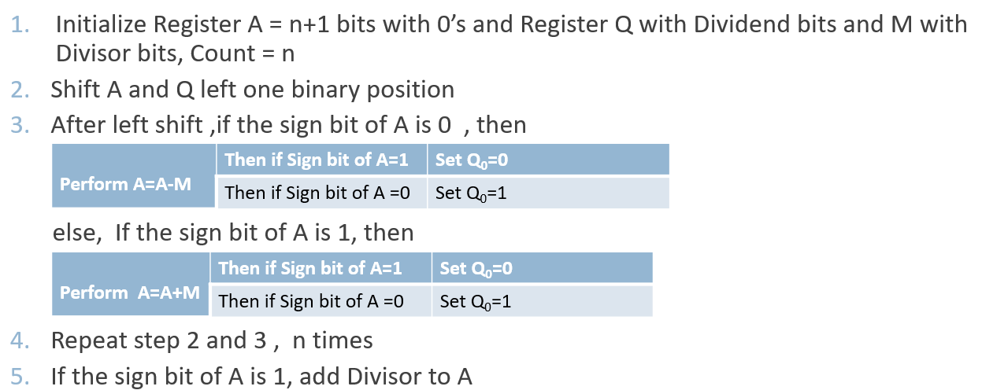
1. Compute 8/3 using nonrestoring division
1
0
1
1
1
0
0
0
A
Q
1
1
1
M = 0 0 0 1 1
1
0
Initially
0
0
0
0
0
1
0
0
0
Shift
0
0
0
0
1
0
0
0
First cycle
Subtract
1
1
1
0
1
M = 0 0 0 1 1
1 1 1 0 0
1
1 1 1 0 1
Set
q
0
1
1
1
1
0
0
0
0
0
Shift
1
1
1
0
0
0
0
0
Add
0
0
0
1
1
Second cycle
Set
q
0
1
1
1
1
1
0
0
0
0
Shift
1
1
1
1
0
0
0
0
1
1
1
1
1
Restore
remainder
Add
0
0
0
1
1
Third cycle
0
0
0
1
1
Set
q
0
0
0
0
0
1
0
0
0
1
Add
0
0
0
1
0
Remainder
Shift
0
0
0
1
0
0
0
1
Subtract
1
1
1
0
1
Fourth cycle
Set
q
0
1
1
1
1
1
0
0
1
0
Quotient
Notes:
‹#›

Slide 124
Examples for Nonrestoring division
State and apply non-restoring division algorithm to perform integer division 59/5.
Perform Nonrestoring division 10/3
Perform Nonrestoring division 11/5
Perform Nonrestoring division 23/5
DEPARTMENT OF COMPUTER SCIENCE AND ENGINEERING

Slide 125
UNIT 2 – Arithmetic unit
Multiplication of two Numbers
A Signed Operand Multiplication
  Booth algorithm
Fast Multiplication
  Bit pair recoding
  Carry Save Addition(CSA)
Integer Division
  Restoring Division
  Nonrestoring Division
IEEE standard for floating point numbers

Slide 126
IEEE standard for floating point numbers
  The IEEE Standard for Floating-Point Arithmetic is a technical standard for floating-point computation which was established in 1985 by the Institute of Electrical and Electronics Engineers (IEEE).
  The standard addressed many problems found in the diverse floating point implementations that made them difficult to use reliably and reduced their portability.
  IEEE Standard floating point is the most common representation today for real numbers on computers, including Intel-based PC’s, Macs, and most Unix platforms.
DEPARTMENT OF COMPUTER SCIENCE AND ENGINEERING

Slide 127
IEEE standard for floating point numbers
Datatype Representation
  Fixed Point number
  Floating Point number
  Fixed Point number
  (+7)₁₀ = (0 111)₂
  (-7)₁₀ = (100 1)₂
0 1 1 1
1 0 0 0
1
----------
1 0 0 1
DEPARTMENT OF COMPUTER SCIENCE AND ENGINEERING

Slide 128
IEEE standard for floating point numbers
  Floating Point numbers -It has 3 parts
  Mantissa (M)
  Base (B)
  Exponent (E)
Scientific Notation M x B^{E}
Number | M | B | E
9 x 10⁸ | 9 | 10 | 8
110 x 2⁷ | 110 | 2 | 7
4364.784 | 4364784 | 10 | -3
DEPARTMENT OF COMPUTER SCIENCE AND ENGINEERING

Slide 129
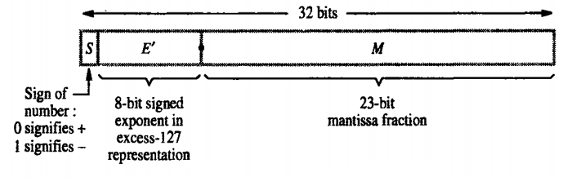

IEEE standard for floating point numbers
  Single Precision format
M x B^{E}
The Sign of Mantissa
0 represents a positive number while 1 represents a negative number.
The Biased exponent
The exponent field needs to represent both positive and negative exponents. A bias is added to the actual exponent in order to get the stored exponent.
The Normalised Mantissa
The mantissa is part of a number in scientific notation or a floating-point number, consisting of its significant digits. Here we have only 2 digits, i.e. O and 1. So a normalised mantissa is one with only one 1 to the left of the decimal.
DEPARTMENT OF COMPUTER SCIENCE AND ENGINEERING

Slide 130
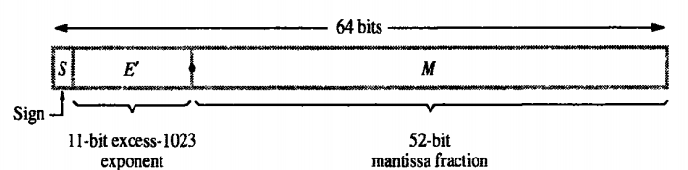

IEEE standard for floating point numbers
  Double Precision format
  Normalize
M x B^{E}
DEPARTMENT OF COMPUTER SCIENCE AND ENGINEERING

Slide 131
Example
1.Represent (1259.125)₁₀ in single and double precision IEEE floating point format.
Solution
Step 1: Convert decimal to Binary form
Step 2: Normalize the number
Step 3: Represent in Single precision form
Step 4: Represent in double precision form
DEPARTMENT OF COMPUTER SCIENCE AND ENGINEERING

Slide 132
Example
1.Represent (1259.125)₁₀ in single and double precision IEEE floating point format.
Solution
Step 1: Convert decimal to Binary form
(1259)₁₀ | 10011101011
(0.125)₁₀ | 0.125 x 2 = 0.25 | 0 | 001
 | 0.25 x 2 = 0.5 | 0
 | 0.5 x 2 = 1 | 1
(1259.125)₁₀ = (10011101011.001)
DEPARTMENT OF COMPUTER SCIENCE AND ENGINEERING

Slide 133


Example
1.Represent (1259.125)₁₀ in single and double precision IEEE floating point format.
Solution
Step 2: Normalize the number
🡪 1.0011101011001 x 2¹⁰
(1259.125)₁₀ = (10011101011.001)
DEPARTMENT OF COMPUTER SCIENCE AND ENGINEERING

Slide 134

Example
1.Represent (1259.125)₁₀ in single and double precision IEEE floating point format.
Solution
Step 3: Represent in Single precision form
🡪 1.0011101011001 x 2¹⁰
🡪 2¹⁰
E’ - 127 = 10 E’ = 10+ 127
E’ = 137 🡪 Binary form 10001001
0 | 10001001 | 0011101011001000000000
S-1bit | E’ -8bits | M- 23bits
DEPARTMENT OF COMPUTER SCIENCE AND ENGINEERING

Slide 135
Example
1.Represent (1259.125)₁₀ in single and double precision IEEE floating point format.
Solution
Step 4: Represent in Double precision form
🡪 1.0011101011001 x 2¹⁰
🡪 2¹⁰
E’ - 1023 = 10 E’ = 10+ 1023
E’ = 1033 🡪 Binary form 10000001001
0 | 10000001001 | 001110101100100…..0000
S-1bit | E’ -11bits | M- 52bits
DEPARTMENT OF COMPUTER SCIENCE AND ENGINEERING

Slide 136
Example
2. Compute the single precision IEEE 754 binary representation of the number (−118.625)₁₀.
Solution
Step 1: Convert decimal to Binary form
(118)₁₀ | 1110110
(0.625)₁₀ | 0.625 x 2 = 1.25 | 1 | 101
 | 0.25 x 2 = 0.5 | 0
 | 0.5 x 2 = 1 | 1
(118.625)₁₀ = (1110110.101)₂
DEPARTMENT OF COMPUTER SCIENCE AND ENGINEERING

Slide 137
Example
2.Compute the single precision IEEE 754 binary representation of the number (−118.625)₁₀.
Step 2: Normalize the number
🡪 1.110110101 x 2⁶
(118.625)₁₀ = (1110110.101)₂
DEPARTMENT OF COMPUTER SCIENCE AND ENGINEERING

Slide 138
Example
2.Compute the single precision IEEE 754 binary representation of the number (−118.625)₁₀.
Step 3: Represent in Single precision form
🡪 1.110110101 x 2⁶
🡪 2⁶
E’ - 127 = 6 E’ = 6+ 127
E’ = 133 🡪 Binary form 10000101
1 | 10000101 | 110110101000…000000
S-1bit | E’ -8bits | M- 23bits
DEPARTMENT OF COMPUTER SCIENCE AND ENGINEERING

Slide 139
Example
3.Represent (85.125)₁₀ in single and double precision IEEE floating point format.
Solution
Step 1: Convert decimal to Binary form
(85)₁₀ | 1010101
(0.125)₁₀ | 0.125 x 2 = 0.25 | 0 | 001
 | 0.25 x 2 = 0.5 | 0
 | 0.5 x 2 = 1 | 1
(85.125)₁₀ = (1010101.001)
DEPARTMENT OF COMPUTER SCIENCE AND ENGINEERING

Slide 140
Example
3.Represent (85.125)₁₀ in single and double precision IEEE floating point format.
Step 2: Normalize the number
🡪 1.010101001 x 2⁶
(85.125)₁₀ = (1010101.001)
DEPARTMENT OF COMPUTER SCIENCE AND ENGINEERING

Slide 141
Example
10000101
3.Represent (85.125)₁₀ in single and double precision IEEE floating point format.
Step 3: Represent in Single precision form
🡪 1.010101001 x 2⁶
🡪 2⁶
E’ - 127 = 6 E’ = 6+ 127
E’ = 133 🡪 Binary form 10001001
0 | 10000101 | 01010100100000..0000
S-1bit | E’ -8bits | M- 23bits
DEPARTMENT OF COMPUTER SCIENCE AND ENGINEERING

Slide 142
Example
3.Represent (85.125)₁₀ in single and double precision IEEE floating point format.
Step 4: Represent in Double precision form
🡪 1.010101001 x 2⁶
🡪 2⁶
E’ - 1023 = 6 E’ = 6+ 1023
E’ = 1029 🡪 Binary form 10000000101
0 | 10000000101 | 01010100100………..0000
S-1bit | E’ -11bits | M- 52bits
DEPARTMENT OF COMPUTER SCIENCE AND ENGINEERING

Slide 143
Example
4.Represent (263.3)₁₀ in single precision IEEE floating point format.
Solution
Step 1: Convert decimal to Binary form
0.3 *2= 0.6 🡪 0
0.6 *2= 1.2 🡪 1
0.2 *2= 0.4🡪 0
0.4 *2 = 0.8 🡪 0
0.8 *2= 1.6 🡪 1
0.6 *2 =1.2 🡪 1
0.2 *2= 0.4🡪 0
0.4 *2 = 0.8 🡪 0
0.8 *2= 1.6 🡪 1
0.6 *2 =1.2 🡪 1
0.2 *2= 0.4🡪 0
0.4 *2 = 0.8 🡪 0
0.8 *2= 1.6 🡪 1
(263)₁₀ | 100000111
(0.3)₁₀ | 0.3 x 2 = 0.6 | 0 | 010011001….
 | 0.6 x 2 = 1.2 | 1
 | 0.2 x 2 = 0.4 | 0
 | 0.4 x 2 = 0.8 | 0
 | 0.8 x 2 = 1.6 | 1
(263.3)₁₀ = (100000111. 010011001….)
DEPARTMENT OF COMPUTER SCIENCE AND ENGINEERING

Slide 144
Example
4.Represent (263.3)₁₀ in single precision IEEE floating point format.
Solution
Step 2: Normalize the number
🡪 1.00000111010011001…… x 2⁸
(263.3)₁₀ = (100000111. 010011001….)
DEPARTMENT OF COMPUTER SCIENCE AND ENGINEERING

Slide 145
Example
4.Represent (1259.125)₁₀ in single precision IEEE floating point format.
Solution
Step 3: Represent in Single precision form
🡪 1.00000111010011001…… x 2⁸
🡪 2⁸
E’ - 127 = 8 E’ = 8+ 127
E’ = 135 🡪 Binary form 10000111
0 | 10000111 | 00000111010011001……
S-1bit | E’ -8bits | M- 23bits
DEPARTMENT OF COMPUTER SCIENCE AND ENGINEERING

Slide 146
Examples
1.Use IEEE single and double precision formats to represent the following floating point numbers.
i) 120.75 ii) -875.45
2. Represent the following in binary using IEEE 754 Double precision format:
i) 12.0875 ii) 0.625.
3. Show the following numbers using IEEE double precision formats.
i)124.45 ii) -369.25.
4. Represent -307.1875 in single and double precision IEEE floating point numbers.
DEPARTMENT OF COMPUTER SCIENCE AND ENGINEERING

Slide 147
UNIT 2 – Arithmetic unit & Processing unit
Multiplication of two Numbers
A Signed Operand Multiplication
  Booth algorithm
Fast Multiplication
  Bit pair recoding
  Carry Save Addition(CSA)
Integer Division
    Restoring Division
    No restoring Division
IEEE standard for floating point numbers
Fundamental concepts
Execution of complete instruction
Multiple bus organization
Hardwired control
Microprogrammed control
DEPARTMENT OF COMPUTER SCIENCE AND ENGINEERING

Slide 148
Fundamental concepts
Processor
  Data processing unit
  Control unit
Data processing unit
  Collection of functional unit capable of performing certain data operations on data
Control unit
  Issues control signals to data processing part to perform operation on data
DEPARTMENT OF COMPUTER SCIENCE AND ENGINEERING
Notes:
‹#›

Slide 149
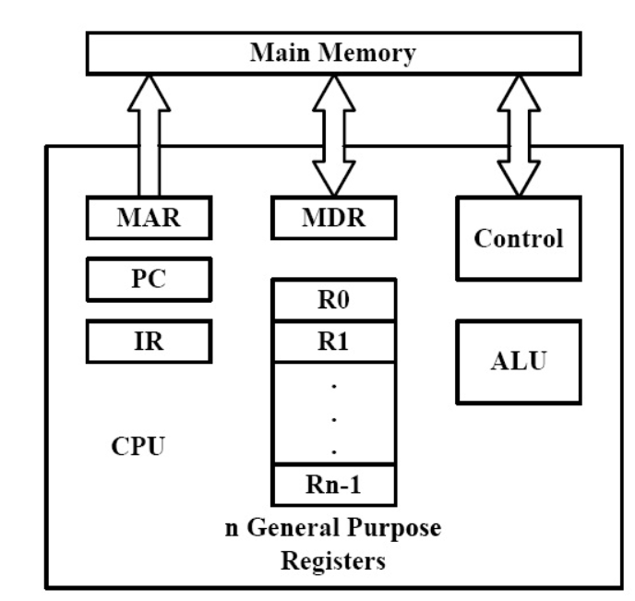
Fundamental Concepts
To execute a program
  Processor fetches one instruction at a time and perform the operation specified.
  Instructions are fetched from successive memory locations until a branch or a jump instruction is encountered.
  Processor keeps track of the address of the memory location containing the next instruction to be fetched using Program Counter (PC).
  Instruction Register (IR)
DEPARTMENT OF COMPUTER SCIENCE AND ENGINEERING
Notes:
‹#›

Slide 150
Fundamental Concepts
To Execute an Instruction
Fetch the contents of the memory location pointed to by the PC. The contents of this location are loaded into the IR (fetch phase).
IR ← [[PC]]
2. Assuming that the memory is byte addressable, increment the contents of the PC by 4 (fetch phase).
PC ← [PC] + 4
3. Carry out the actions specified by the instruction in the IR (execution phase).
DEPARTMENT OF COMPUTER SCIENCE AND ENGINEERING
Notes:
‹#›

Slide 151
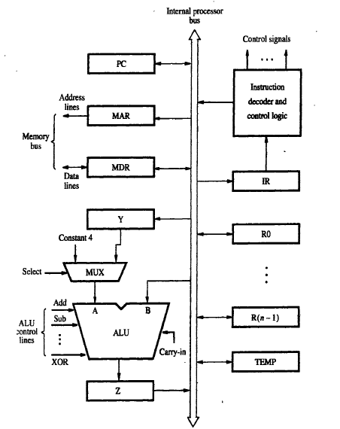
Fundamental Concepts
SINGLE BUS ORGANIZATION
Bus is communication system that transfers data between component inside a computer, or between computers.
In Single bus organization, one data item can be transferred over the bus in a clock cycle
DEPARTMENT OF COMPUTER SCIENCE AND ENGINEERING
Notes:
‹#›

Slide 152
Fundamental Concepts
SINGLE BUS ORGANIZATION
  ALU and all the registers are interconnected via a single common bus
  The data and address lines of the external memory bus connected to the internal processor bus via the memory data register (MDR), and the memory address register(MAR) respectively.
DEPARTMENT OF COMPUTER SCIENCE AND ENGINEERING
Notes:
‹#›

Slide 153
Fundamental Concepts
SINGLE BUS ORGANIZATION
  Register MDR has two inputs and two outputs.
  Data may be loaded into MDR either from the memory bus or from the internal processor bus.
  Data stored in MDR may be placed on either bus.
  The input of MAR is connected to the internal bus, and its output is connected to the external bus.
DEPARTMENT OF COMPUTER SCIENCE AND ENGINEERING
Notes:
‹#›

Slide 154
Fundamental Concepts
SINGLE BUS ORGANIZATION
  The control lines of the memory bus are connected to the instruction decoder and control logic.
  This unit is responsible for issuing the signals that control the operation of all the units inside the processor and for increasing with the memory bus.
DEPARTMENT OF COMPUTER SCIENCE AND ENGINEERING
Notes:
‹#›

Slide 155
Fundamental Concepts
SINGLE BUS ORGANIZATION
  Register R0 through R(n-1) are the Processor Registers. The programmer can access these registers for general-purpose use.
  Only processor can access 3 registers Y, Z & Temp for temporary storage during program-execution. The programmer cannot access these 3 registers.
DEPARTMENT OF COMPUTER SCIENCE AND ENGINEERING
Notes:
‹#›

Slide 156
Fundamental Concepts
SINGLE BUS ORGANIZATION
  ALU
    A input gets the operand from the output of the multiplexer (MUX).
    B input gets the operand directly from the processor-bus.
  MUX is used to select one of the 2 inputs.
  MUX selects either output of Y or constant-value 4( which
  is used to increment PC content).
DEPARTMENT OF COMPUTER SCIENCE AND ENGINEERING
Notes:
‹#›

Slide 157
Fundamental Concepts
SINGLE BUS ORGANIZATION
Advantage : Simplest and also this is very cheap to implement.
Disadvantage: Only one data-word can be transferred over the bus in a clock cycle.
Solution: Provide multiple internal-paths.
Multiple paths allow several data-transfers to take place in parallel.
DEPARTMENT OF COMPUTER SCIENCE AND ENGINEERING
Notes:
‹#›

Slide 158
Fundamental Concepts
  An instruction is executed by performing one or more of the following operations:
  Transfer a word of data from one register to another or to the ALU.
  Perform arithmetic or a logic operation and store the result in a register.
  Fetch the contents of a given memory-location and load them into a register.
  Store a word of data from a register into a given memory-location.
SINGLE BUS ORGANIZATION
DEPARTMENT OF COMPUTER SCIENCE AND ENGINEERING
Notes:
‹#›

Slide 159
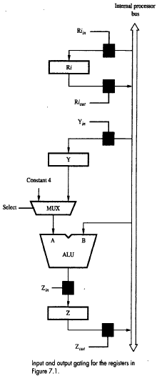
Fundamental Concepts
1. Register Transfers
Instruction execution involves a sequence of steps in which data are transferred from one register to another.
For each register two control signals are used to place the contents of that register on the bus or to load the data on the bus into register as shown in figure.
DEPARTMENT OF COMPUTER SCIENCE AND ENGINEERING

Slide 160
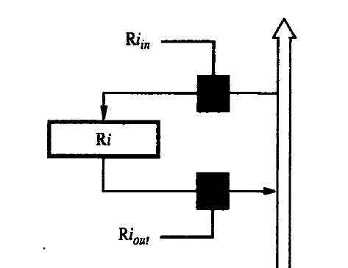
Fundamental Concepts
For each register two control signals are used
  Ri_{in} =1 ,load the data on the bus into register
  Ri_{out} =1, place the contents of that register on the bus
Ri_{out} = 0, the bus can be used for transferring data from other registers.
DEPARTMENT OF COMPUTER SCIENCE AND ENGINEERING

Slide 161
Fundamental Concepts
Suppose we wish to transfer the contents of register R1 to register R4.
Enable the output of registers R1 by setting R1out to 1. This places the contents of R1 on the processor bus.
Enable the input of register R4 by setting R4int to 1. This loads data from the processor bus into register R4.
All operations and data transfers with in the processor take place with in time periods defined by the processor clock.
R1
R4
DEPARTMENT OF COMPUTER SCIENCE AND ENGINEERING

Slide 162
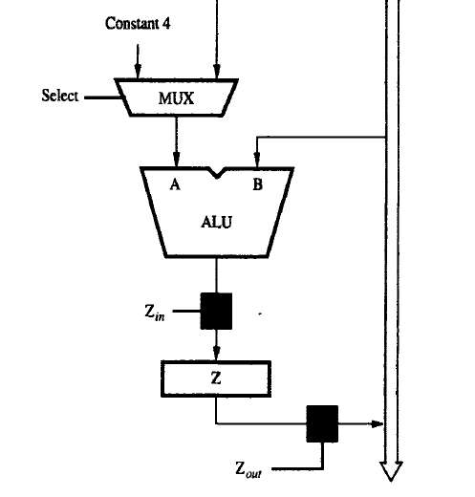
Fundamental Concepts
2.Performing an Arithmetic or Logic Operation
The ALU is a combinational circuit that has no internal storage.
ALU gets the two operands from MUX and bus. The result is temporarily stored in register Z.
DEPARTMENT OF COMPUTER SCIENCE AND ENGINEERING
Notes:
‹#›

Slide 163
Fundamental Concepts
2.Performing an Arithmetic or Logic Operation
What is the sequence of operations to add the contents of register R1 to those of R2 and store the result in R3?
  R1out, Yin
  R2out, SelectY, Add, Zin
  Zout, R3in
DEPARTMENT OF COMPUTER SCIENCE AND ENGINEERING
Notes:
‹#›

Slide 164
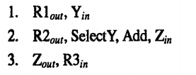
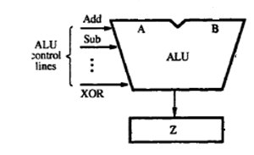
Fundamental Concepts
R1
Y
2.Performing an Arithmetic or Logic Operation
Step 1
Output of register R1 and the input of register Y are enabled, causing the contents of R1 to be transferred over the bus to Y.
Step 2
Multiplexer’s select signal is set to Select Y, causing the multiplexer to gate the contents of register Y to input A of the ALU
Register R2 content is input to B
ADD line is set to 1, causing the output of the ALU to load the sum into register Z
Step 3
Content of register Z are transferred to the destination register R3.
Select
MUX
R2
R3
DEPARTMENT OF COMPUTER SCIENCE AND ENGINEERING
Notes:
‹#›

Slide 165
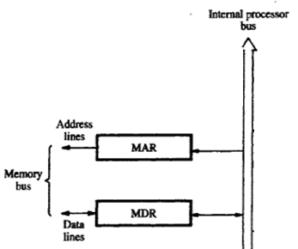
Fundamental Concepts
3.Fetching a Word from Memory
The processor has to specify the address of the memory location where this information is stored and request a Read operation.
This applies whether the information to be fetched represents an instruction in a program or an operand specified by an instruction.
The processor transfers the required address to the MAR, whose output is connected to the
address lines of the memory bus.
DEPARTMENT OF COMPUTER SCIENCE AND ENGINEERING
Notes:
‹#›

Slide 166
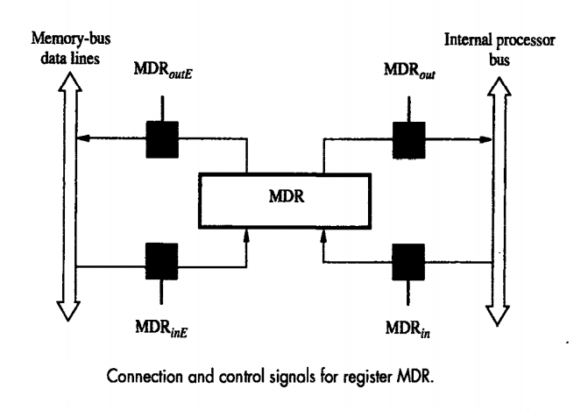
Fundamental Concepts
3.Fetching a Word from Memory
  At the same time , the processor uses the control lines of the memory bus to indicate that a Read operation is needed.
  When the requested data are received from the memory they are stored in register MDR, from where they can be transferred to other registers in the processor.
  Processor waits until it receives an indication that the requested operation
  has been completed (Memory-Function-Completed, MFC).
DEPARTMENT OF COMPUTER SCIENCE AND ENGINEERING
Notes:
‹#›

Slide 167
Fundamental Concepts
3.Fetching a Word from Memory
  Example: Move (R1), R2
MAR ← [R1]
Start a Read operation on the memory bus Wait for the MFC response from the memory Load MDR from the memory bus
R2 ← [MDR]
DEPARTMENT OF COMPUTER SCIENCE AND ENGINEERING
Notes:
‹#›

Slide 168
Fundamental Concepts
4. Storing a word in Memory
The desired address is loaded into MAR.
Then , the data to be written are loaded into MDR, and a write command is issued.
Example: Move R2,(R1) requires the following steps
  1 R1_{out},MAR_{in}
  2.R2_{out},MDR_{in},Write
  3.MDR_{outE},WMFC
DEPARTMENT OF COMPUTER SCIENCE AND ENGINEERING
Notes:
‹#›

Slide 169
UNIT 2 – Arithmetic unit & Processing unit
Fundamental concepts
Execution of complete instruction
Multiple bus organization
Hardwired control
Microprogrammed control
DEPARTMENT OF COMPUTER SCIENCE AND ENGINEERING

Slide 170
Execution of a Complete Instruction
Sequence of elementary operations required to execute one instruction using Single Bus organization
2 Phases:
  Fetch Phase( Step 1 to Step 3)
  Execution Phase(Step 4 to Step 7)
Example : Add (R3), R1
  Fetch the instruction
  Fetch the first operand (the contents of the memory location pointed to by R3)
  Perform the addition
  Load the result into R1
DEPARTMENT OF COMPUTER SCIENCE AND ENGINEERING
Notes:
‹#›

Slide 171
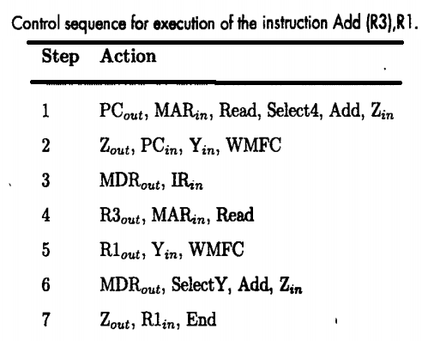
Execution of a Complete Instruction
Step1: : Add (R3), R1
The instruction-fetch operation is initiated by
Load contents of PC into MAR
Send a Read request to memory
The Select signal is set to Select4, which causes the Mux to select constant 4.
This value is added to operand at input B (PC content)
Result is stored in Z.
DEPARTMENT OF COMPUTER SCIENCE AND ENGINEERING
Notes:
‹#›

Slide 172
Execution of a Complete Instruction
Step2:
Updated value in Z is moved to PC.
This completes the PC increment operation
and PC will now point to next instruction,
While waiting for memory to respond
DEPARTMENT OF COMPUTER SCIENCE AND ENGINEERING
Notes:
‹#›

Slide 173
Execution of a Complete Instruction
Step3:
Fetched instruction is moved into MDR and then to IR.
DEPARTMENT OF COMPUTER SCIENCE AND ENGINEERING
Notes:
‹#›

Slide 174
Execution of a Complete Instruction
Step 4:
Instruction decoder interprets the contents of the IR. This enables the control circuitry to activate the control-signals for steps 4 through 7.
Contents of R3 are loaded into MAR & a memory read signal is issued.
DEPARTMENT OF COMPUTER SCIENCE AND ENGINEERING
Notes:
‹#›

Slide 175
Execution of a Complete Instruction
Step 5:
Contents of R1 are transferred to Y to prepare for addition.
DEPARTMENT OF COMPUTER SCIENCE AND ENGINEERING
Notes:
‹#›

Slide 176
Execution of a Complete Instruction
Step 6:
When Read operation is completed, memory-operand is available in MDR, and the addition is performed.
DEPARTMENT OF COMPUTER SCIENCE AND ENGINEERING
Notes:
‹#›

Slide 177
Execution of a Complete Instruction
Step 7:
Sum is stored in Z, then transferred to R1.
The End signal causes a new instruction fetch cycle to begin by returning to step1.
DEPARTMENT OF COMPUTER SCIENCE AND ENGINEERING
Notes:
‹#›

Slide 178
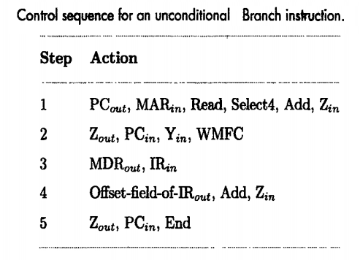
Execution of a Complete Instruction
Execution of Branch Instructions
DEPARTMENT OF COMPUTER SCIENCE AND ENGINEERING
Notes:
‹#›

Slide 179
Execution of a Complete Instruction
Execution of Branch Instructions
Step 1-3 : The processing starts & the fetch phase ends in step3.
Step 4 :The offset-value is extracted from IR by instruction-decoding circuit.
Since the updated value of PC is already available in register Y, the offset X is gated onto the bus, and an addition operation is performed.
Step 5: Result, which is the branch-address, is loaded into the PC.
DEPARTMENT OF COMPUTER SCIENCE AND ENGINEERING
Notes:
‹#›

Slide 180
UNIT 2 – Arithmetic unit & Processing unit
Fundamental concepts
Execution of complete instruction
Multiple bus organization
Hardwired control
Microprogrammed control
DEPARTMENT OF COMPUTER SCIENCE AND ENGINEERING

Slide 181
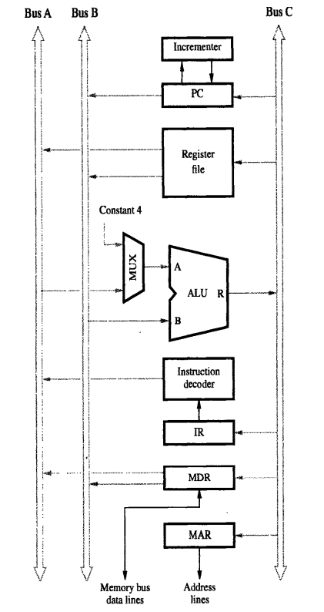
Multiple-Bus Organization
Three buses are used to connect registers and the ALU of the processor.
All general-purpose registers are grouped into a single block called the Register File.
Register-file has 3 ports:
Two output-ports allow the contents of 2 different registers to be simultaneously placed on buses A & B.
Third input-port allows data on bus C to be loaded into a third register during the same clock-cycle.
Buses A and B are used to transfer source-operands to A & B inputs of ALU.
The result is transferred to destination over bus C.
Incrementer Unit is used to increment PC by 4.
DEPARTMENT OF COMPUTER SCIENCE AND ENGINEERING
Notes:
‹#›

Slide 182
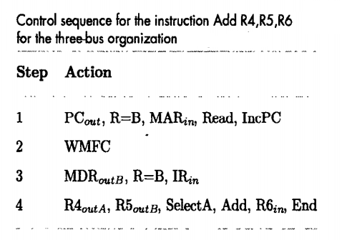
Multiple-Bus Organization
Add R4, R5 ,R6
Step 1: Contents of PC are
  passed through ALU using R=B control-signal
  loaded into MAR to start memory Read operation.
  At the same time, PC is incremented by 4.
Step2 : Processor waits for MFC signal from memory.
Step3: Processor loads requested data into MDR, and then transfers them to IR.
Step4: The instruction is decoded and add operation takes place in a single step.
DEPARTMENT OF COMPUTER SCIENCE AND ENGINEERING
Notes:
‹#›

Slide 183
UNIT 2 – Arithmetic unit & Processing unit
Fundamental concepts
Execution of complete instruction
Multiple bus organization
Hardwired control
Microprogrammed control
DEPARTMENT OF COMPUTER SCIENCE AND ENGINEERING

Slide 184
Design of Control Unit
To execute instructions, the processor must have some means of generating the control signals needed in the proper sequence.
The Control Unit is classified into two major categories:
  Hardwired Control
  Microprogrammed Control
DEPARTMENT OF COMPUTER SCIENCE AND ENGINEERING
Notes:
‹#›

Slide 185
Hardwired control
The Hardwired Control organization involves the control logic to be implemented with gates, flip-flops, decoders, and other digital circuits.
The control hardware can be viewed as a state machine that changes from one state to another in every clock cycle, depending on the contents of the instruction register, the condition codes and the external inputs.
The outputs of the state machine are the control signals.
DEPARTMENT OF COMPUTER SCIENCE AND ENGINEERING
Notes:
‹#›

Slide 186
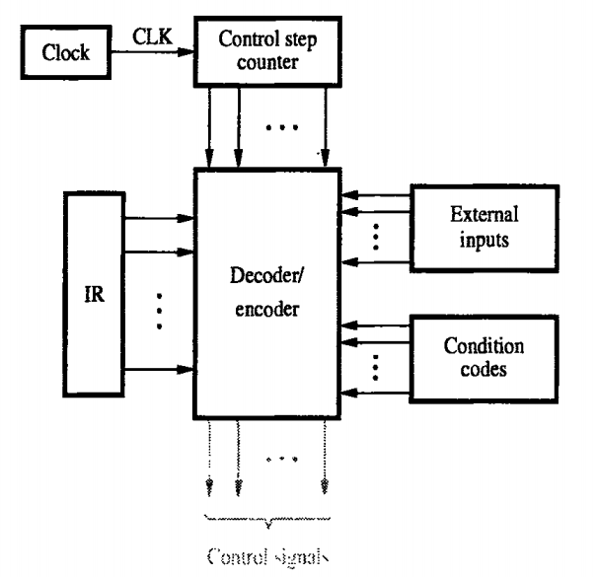
Hardwired control
Add (R3),R1
This instructions adds the content of a memory location pointed by R3 to register R1
Each step in this sequence is completed in one clock period.
Counter tracks the control steps
Each state or count of this counter correspond to one control step
DEPARTMENT OF COMPUTER SCIENCE AND ENGINEERING
Notes:
‹#›

Slide 187
Hardwired control
Control unit depends on
Contents of control step counter
Contents of IR
Contents of Condition codes
External input such as MFC/interrupt request
DEPARTMENT OF COMPUTER SCIENCE AND ENGINEERING
Notes:
‹#›

Slide 188
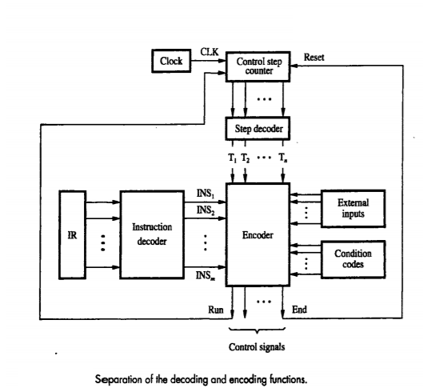
Hardwired control
Decoder/Encoder Block is a combinational-circuit that generates required control-outputs depending on state of all its inputs.
Instruction Decoder(IR) decodes the instruction loaded in the IR, then generates separate output-lines for each machine instruction.
Step-Decoder provides a separate signal line for each step in the control sequence.
Encoder gets the input from instruction decoder, step decoder, external inputs and condition codes and generate individual control-signals
DEPARTMENT OF COMPUTER SCIENCE AND ENGINEERING
Notes:
‹#›

Slide 189
Hardwired control
Advantage: Can operate at high speed.
Disadvantages:
Since no. of instructions/control-lines is often in hundreds, the complexity of control unit is very high.
It is costly and difficult to design.
The control unit is inflexible because it is difficult to change the design.
DEPARTMENT OF COMPUTER SCIENCE AND ENGINEERING
Notes:
‹#›

Slide 190
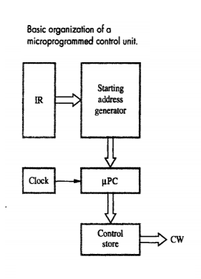
Micro programmed Control
Control signals are implemented with the help of a program
Microprogrammed control unit is a software/program
A control unit with its binary control values stored as words in memory is called as microprogrammed control.
DEPARTMENT OF COMPUTER SCIENCE AND ENGINEERING

Slide 191
Micro programmed Control
Every time instruction is loaded in IR , the output of Starting address generator is loaded into the
The is automatically incremented by the clock, causing successive microinstruction to be read from control store
DEPARTMENT OF COMPUTER SCIENCE AND ENGINEERING

Slide 192
Micro programmed Control
Control Memory stores the microprogram, Microprogram is a collections of microinstructions and each misconstructions is contains one or more microoperations.
Control Store contains the microinstruction that is to be executed
DEPARTMENT OF COMPUTER SCIENCE AND ENGINEERING

Slide 193
Micro programmed Control
Control unit generates the control signal for any instruction by sequentially reading the CW of the corresponding micro routine from the control store
Control Word : A control word is a word whose individual bits represent various control signals.
DEPARTMENT OF COMPUTER SCIENCE AND ENGINEERING

Slide 194
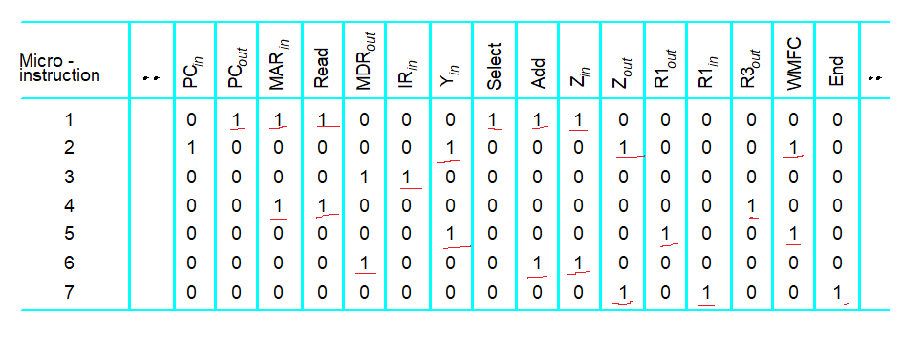
Micro programmed Control - Example
Control signals are generated by a program similar to machine language programs.
DEPARTMENT OF COMPUTER SCIENCE AND ENGINEERING
Notes:
‹#›

Slide 195
Questions
Explain the working of a hardwired control unit with a diagram
Write the sequence of control steps required for the single bus structure for the following instruction Add (R2),R1.
Draw and explain the Single bus organization of a Processor.
4. Draw and explain the multi-bus organization of a Processor.
DEPARTMENT OF COMPUTER SCIENCE AND ENGINEERING
Notes:
‹#›

Slide 196

D
DEPARTMENT OF COMPUTER SCIENCE AND ENGINEERING
‹#›

